Slide 1
Book Fairs
Author Book Selling Success
John Hope

Slide 2
Book Fairs
Author Book Selling Success
Transitioning to the Book-Selling Business
Researching Book Events / Finding Audience
Preparing for a Book Event
Conducting a Book Event
Wrap-up and Lessons Learned

Slide 3
Transitioning to the
Book-Selling Business

Slide 4

Writing vs Book Selling
Writing is an Art
Book Selling is a Business

Slide 5
Writing vs Book Selling
Writing Goals
  Great Characters
  Stirring/Creative Plot
  Strong Themes
Book Selling Goals
  Make Money
  Establish a brand for yourself

Slide 6
Creating a Business
Non-Profitable Businesses
  Requires substantial volunteers / donations
  Requires a Board of Directors
  Or are hobbies
Profitable Businesses
  Can sustain for years

Slide 7
Creating a Business – Officially
Business Licensing
  https://dos.myflorida.com/sunbiz/
Florida Department of Revenue
  http://floridarevenue.com

Slide 8
Creating a Business – Requirements
Mission Statement
  Something that defines your business goals
Record/Maintain an Inventory
  Books and supplies and their values
Record/Maintain Sales and Expenses
  Accounting must be reported to IRS annually
  Florida sales taxes typically paid quarterly

Slide 9
Researching Book Events /
Finding Audience

Slide 10
Book Events
Best methods for finding events:
  Talk to people, network
  Join writer-focused organizations
  Internet searches, especially local events
Not all events have to be BOOK events
  Find events that “fit” your book
  Go where your audience goes

Slide 11
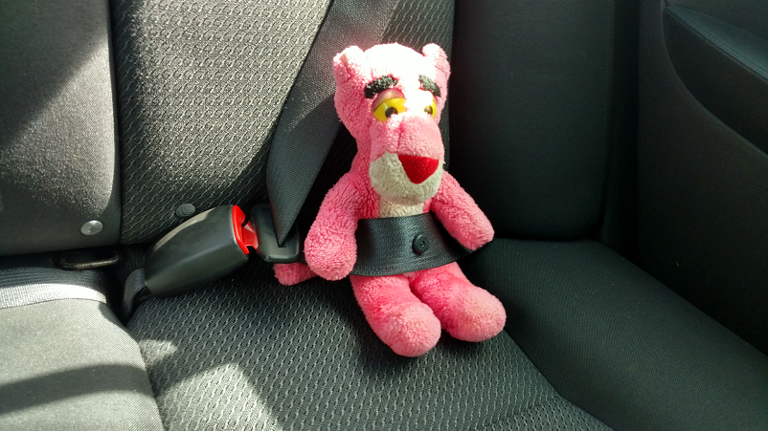
Book Events
Seek well-attended events
  Possibly best-selling authors in attendance
Don’t be afraid to travel
  New York is the book publishing hub of the English-speaking world
  Other areas of the country may have an interest in your topic

Slide 12

Finding Your Audience
To determine your audience, dissect your book
Historical Fiction: 1947
Post WW2 central Florida
Boy acquires brother via adaption
Small town murderer on loose
Backdrop of racism
Coming of age

Slide 13
Preparing for a Book Event

Slide 14
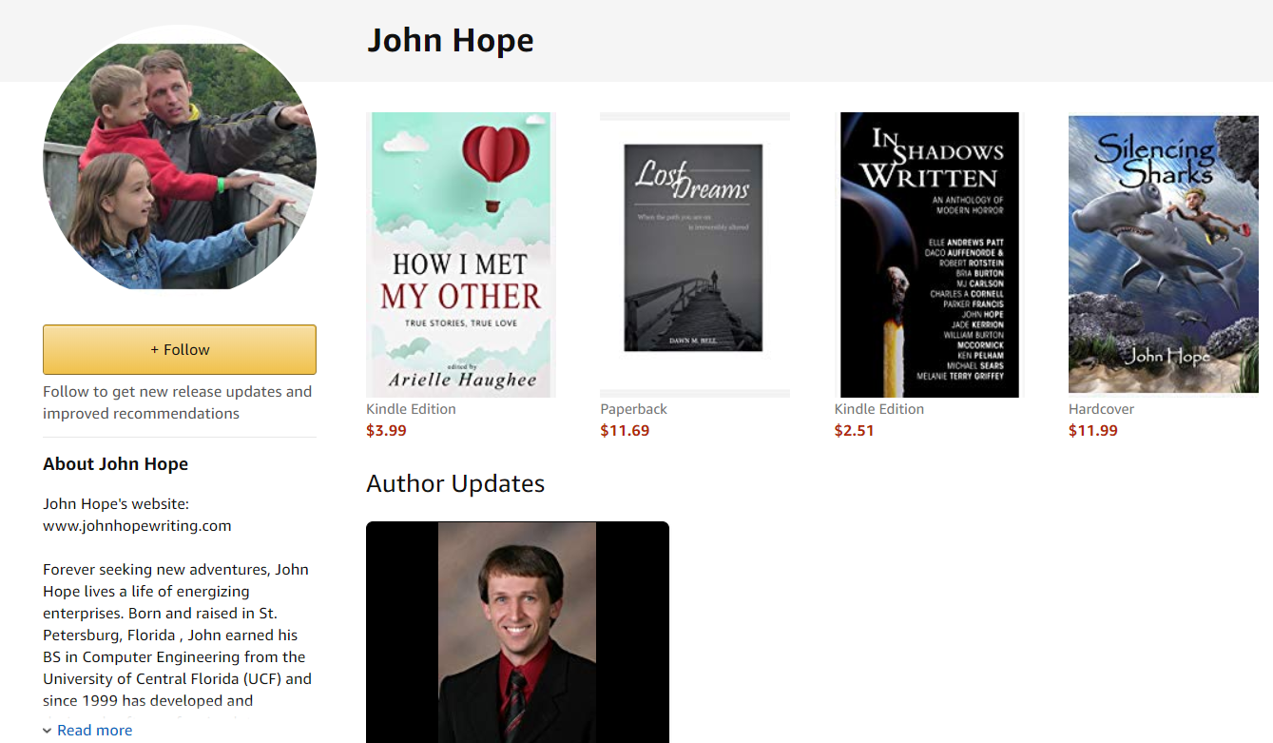
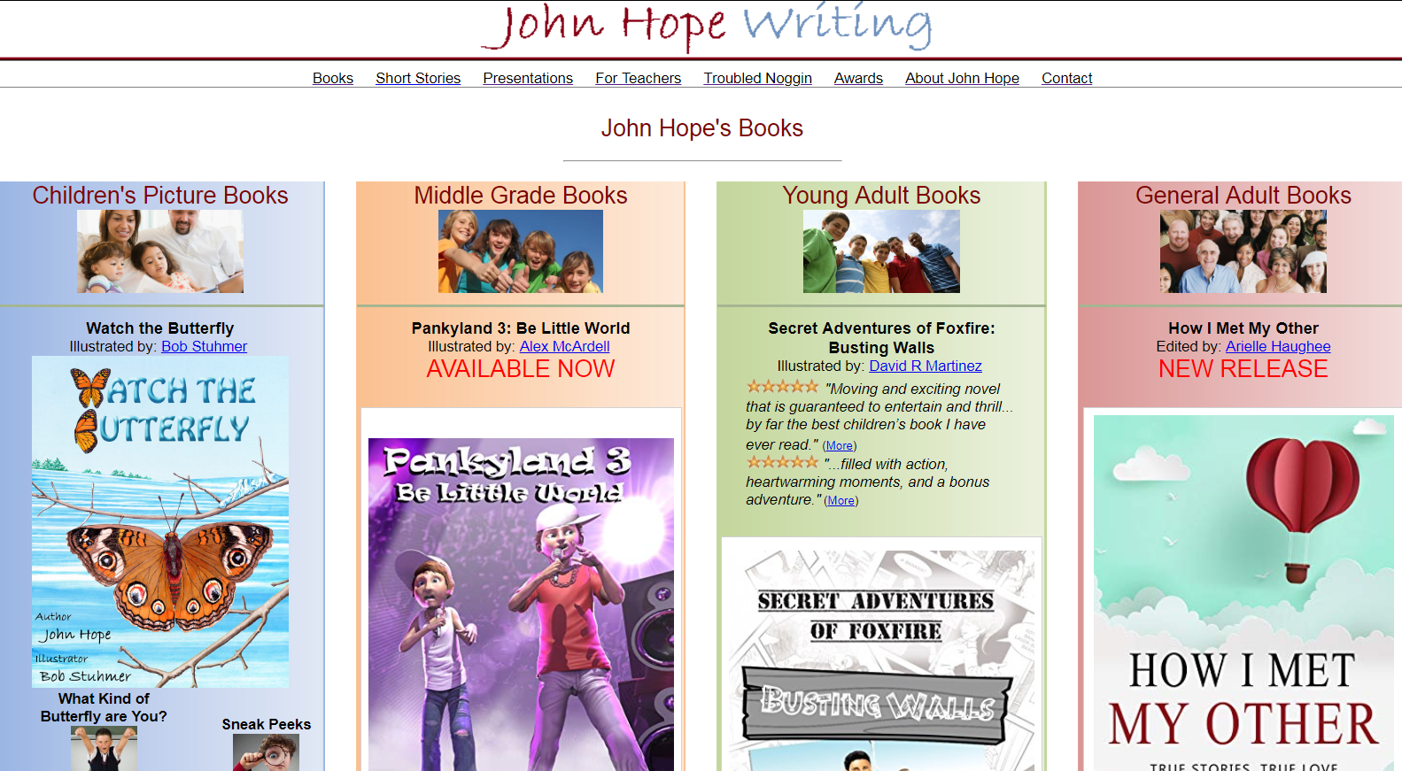
Top Priority: Online Presence
Website / Amazon Page
Twitter / Facebook / Snapchat
Method of Connecting and Buying Books Online
Domain Names Help
JohnHopeWriting.com

Slide 15
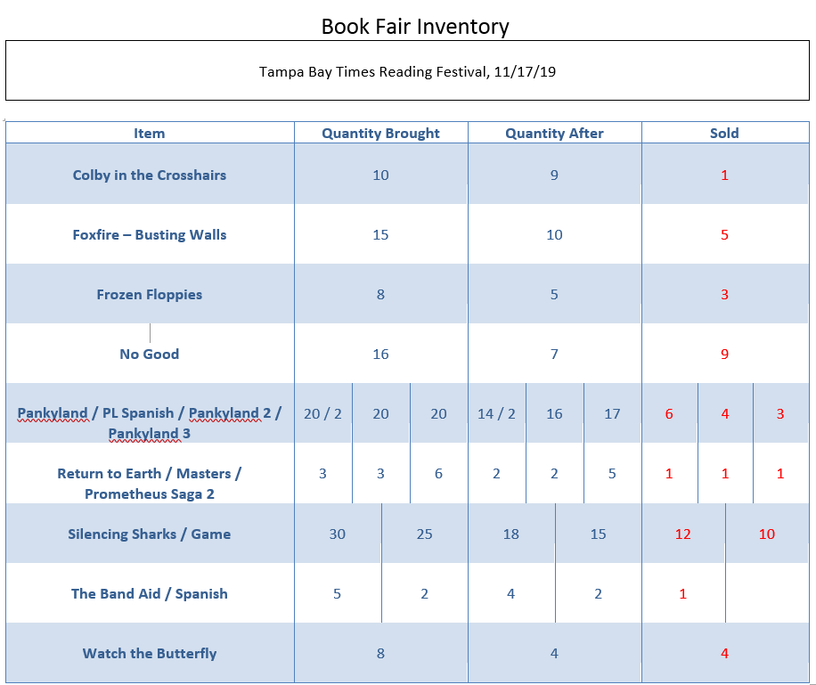
Logging Book Quantities
Make a list of how many books are brought, then update after event

Slide 16
Checklist of Supplies
Table (most book events supply one)
Table Cloth / Covering
Bookstands
Book and/or Author Signs (including price list)
Bookmarks / Business Cards / Brochures
Pen
Freebees
  Consider items that compliment your books

Slide 17
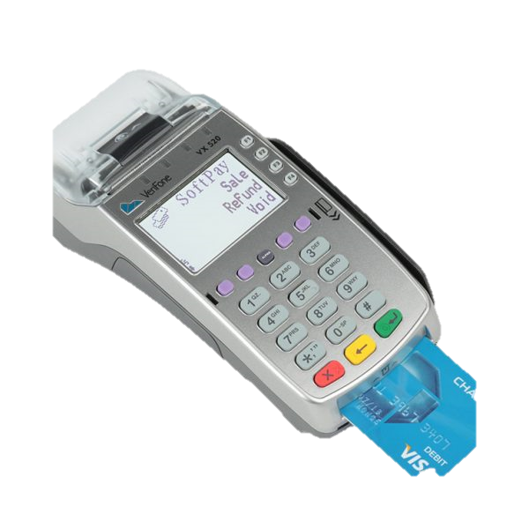
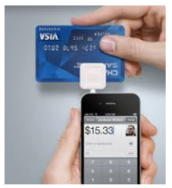
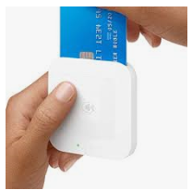
Method of Payments
Bring cash ($1/$5/$10)
Credit Card Implements
  Banks Offer Credit Card Reading Solutions – usually monthly costs
  Square Readers (squareup.com) – flat rates

Slide 18
Putting a Price on Books
The Value of a Book to a Reader
  The more readers pay for a book, the more initial value the book has
  After reading the book, value is largely based off of quality of story/characters
Warning: A book that’s too expensive will never be bought
  Research prices of comparable books

Slide 19
Special Deals / Discounts
Everyone loves a good deal
  Buy one get second at a discount
  Discounts for series of books
  Prize wheel
  Sign up (with email address) for something free/discounted

Slide 20
FreeBees / Handouts
Bookmarks
Pencils
Magnets
Coloring Pages
Brochures
Always include your Website / Online Contact
Printing Services:
  UPrinting.com
  VistaPrint.com

Slide 21
Conducting a Book Event

Slide 22
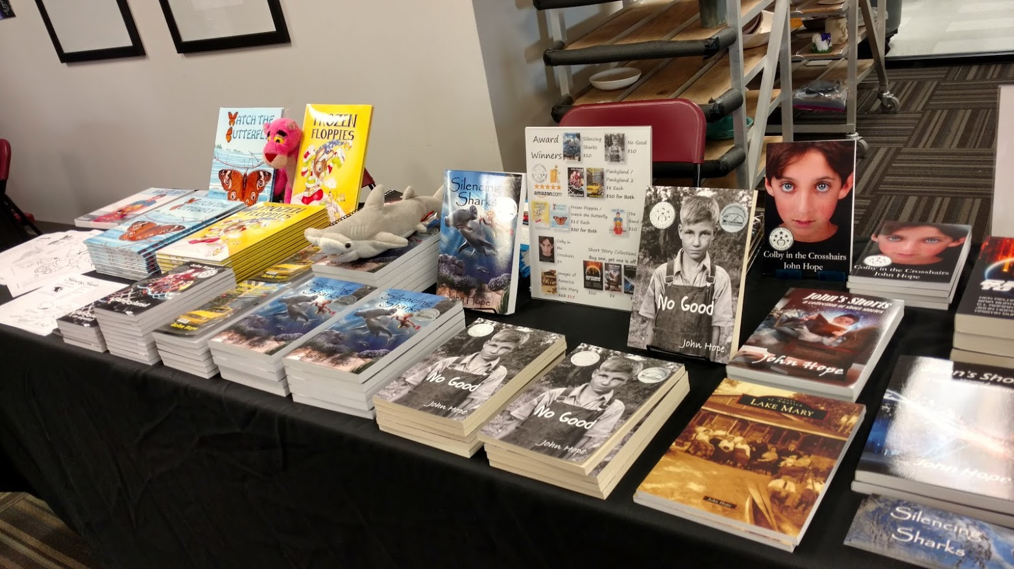
Presentation
Things to Consider:
  Think Like a Bookstore
  Organize for Your Readers
  Display Prices
  Bookstands
  Freebees

Slide 23
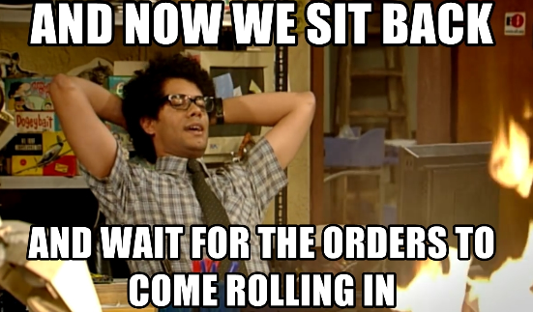
Engaging with Your Readers
Most Writers Sit Back and Wait Method
  Most Reader will not know you
  Readers do not know your books
  Readers are generally passive people and may not want to start the conversation

Slide 24
Engaging with Your Readers
Goals When Engaging Readers
  Show them you are friendly / approachable
  Learn what they like to read and/or what they are looking for
  Match the reader to the book
  Express why your books are awesome

Slide 25
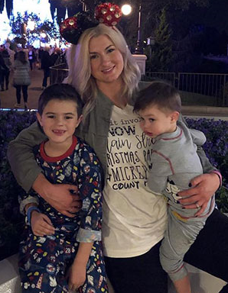
Sell Yourself First
No matter how good your books are, readers need to accept you first
Many people will consider your books simply because they like you
How to sell yourself
  Friendly greeting (“Good morning!”)
  Joke around with them
  Be genuine and sympathetic toward them

Slide 26

Initial Greeting
Freebees / Handouts help a lot
Target your audience
Tell them briefly about you and your books when you hand them something, but don’t brag
  “Hello. I write romantic thrillers.”

Slide 27
Selling Your Book
Show Book Cover
  People DO judge a book by its cover
Recite Book Blurb
  Catchy hook that makes your book different and interesting
Open Book and Place into Reader’s Hands
Get the Reader Talking
  What do they like to read?
Share Why Book is a Good Fit (if it is)

Slide 28

Selling Your Book
People will pay for a book if the book is worth more than their money
Great Cover Art
Fun Characters
$5
Exciting
Topic of Interest
$20
$10
Intriguing Plot
Nicely Printed Book

Slide 29


Selling Your Book
Keep in mind…
  People don’t NEED your book
  You’re trying to deliver happiness

Slide 30
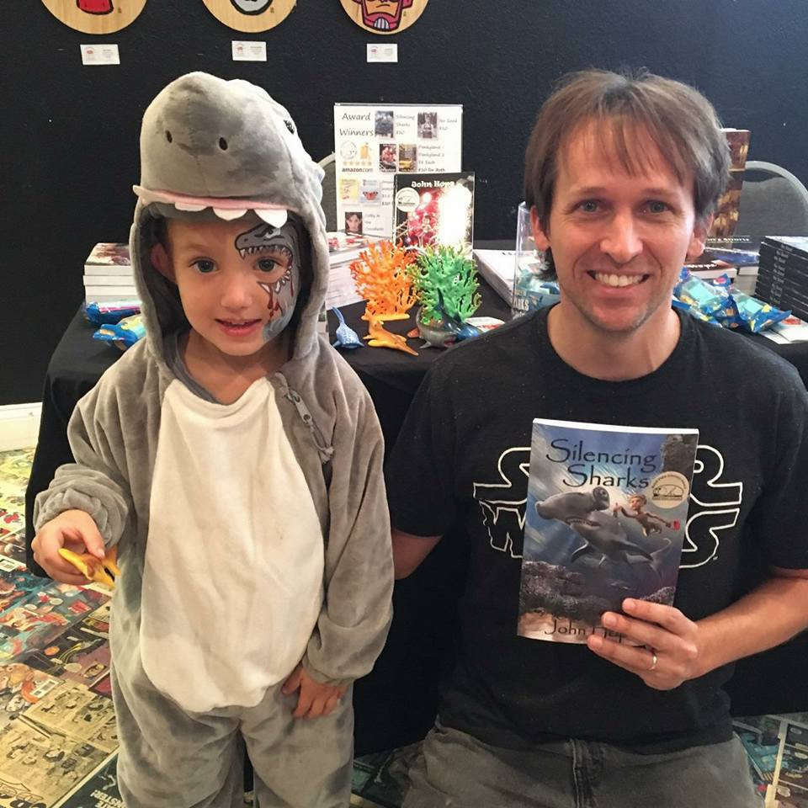
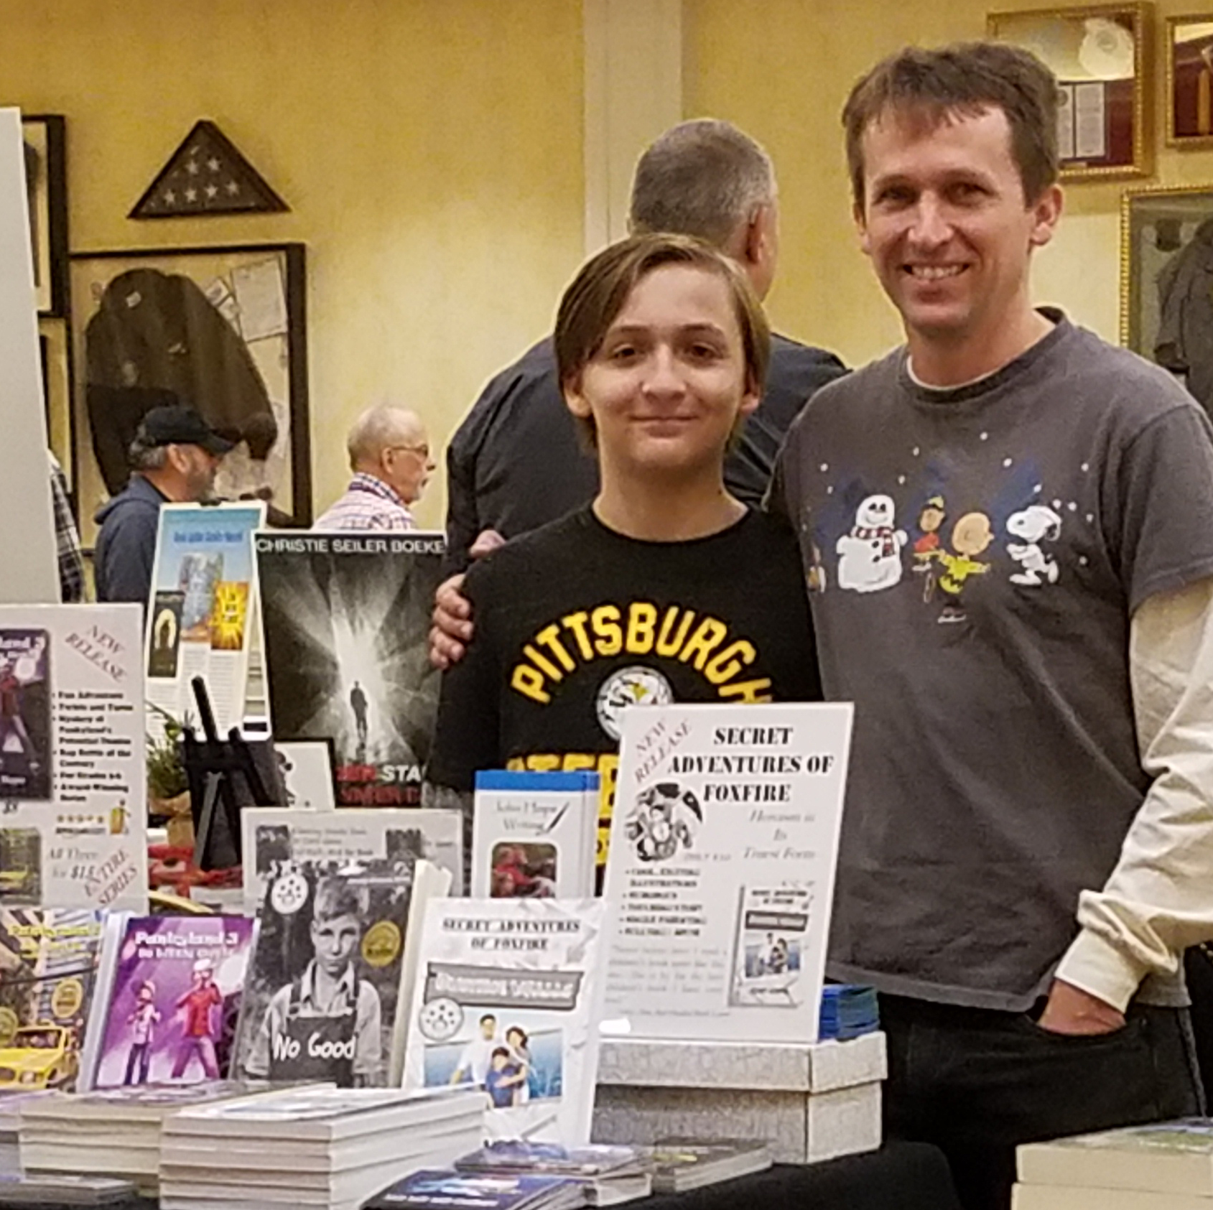
Selling Your Book
Having a helper to handle transactions helps to keep you focused on your audience
Have fun – sign books, personalize, take photos

Slide 31
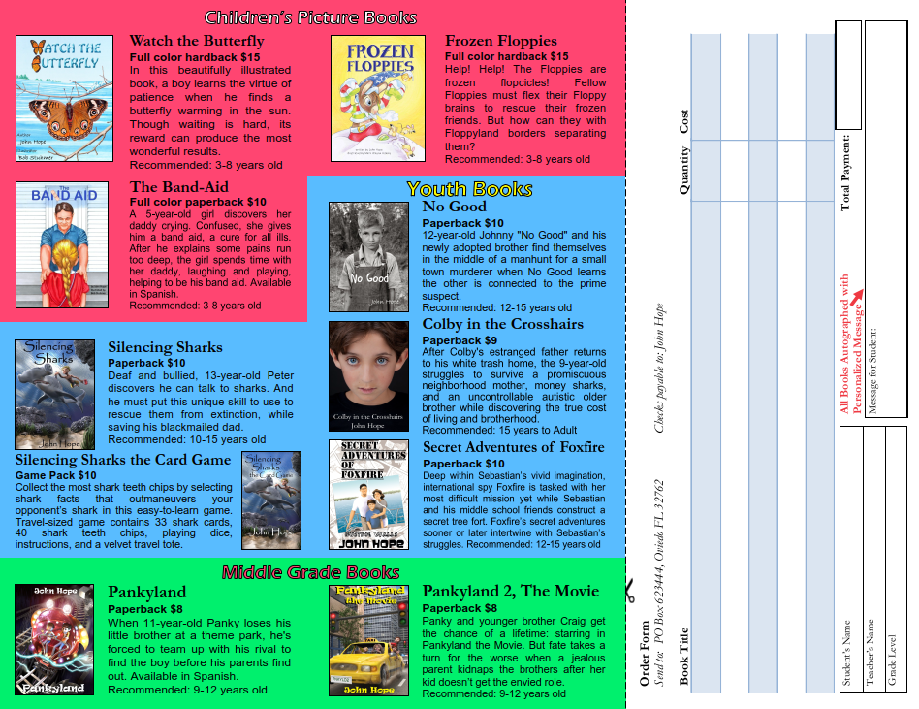

NOT Selling Your Book
Not selling a book is not a total loss
  Hopefully, you made a good impression on people
  Hand them your brochure so they can look you and your books up
  Wish them a great day

Slide 32
Wrap-up and Lessons Learned

Slide 33
Wrap-up and Lessons Learned
Tally sales
  What is selling?
  Why did your books sell?
  What didn’t sell?
  Why didn’t your books sell?
Answers to these questions may steer your next event, and possibly your next book

Slide 34
Wrap-up and Lessons Learned
The business end…
  Calculate sales tax and pay the Department of Revenue
  Maintain an inventory of your books for Federal Income Taxes
  Review your supplies, determine what you need to reorder

Slide 35
Wrap-up and Lessons Learned
Follow-up on Contacts Made
  Thank people via Email
  Send email newsletters to whoever signed up – offer free / promotional items
  Schedule additional events

Slide 36

Wrap-up and Lessons Learned
Stay focused, don’t give up
  This is a hard, competitive industry

Slide 37
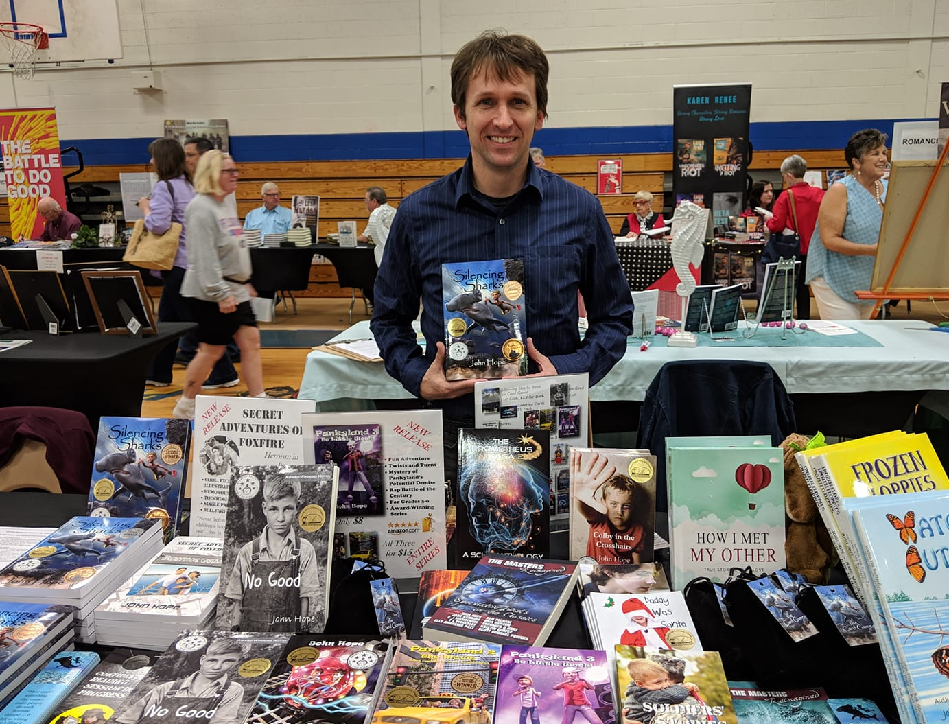
Questions?

