Slide 1
Children’s Writing that Sells
John Hope

Slide 2
Children’s Writing that Sells
Children’s Writing Overview
Think Like a Child
Think Like a Teacher/Parent
Efficient Visual Writing
Working with an Illustrator
Marketing / Networking

Slide 3
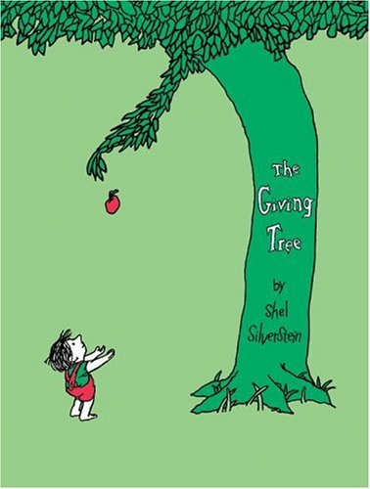
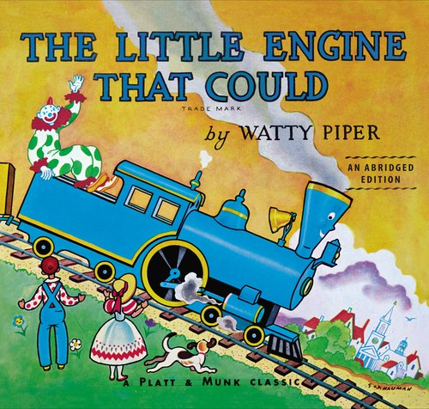
Children’s Writing Overview
Children’s picture books average 1,000 words
Range 50 to 2,500 words
985 words
621 words
338 words
1,626 words

Slide 4
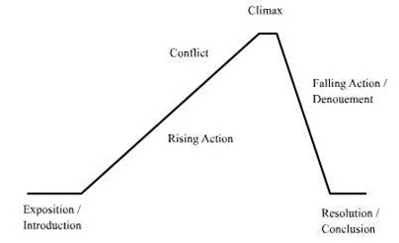
Children’s Writing Overview
Short Story Approach

Slide 5
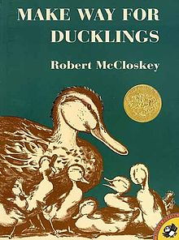
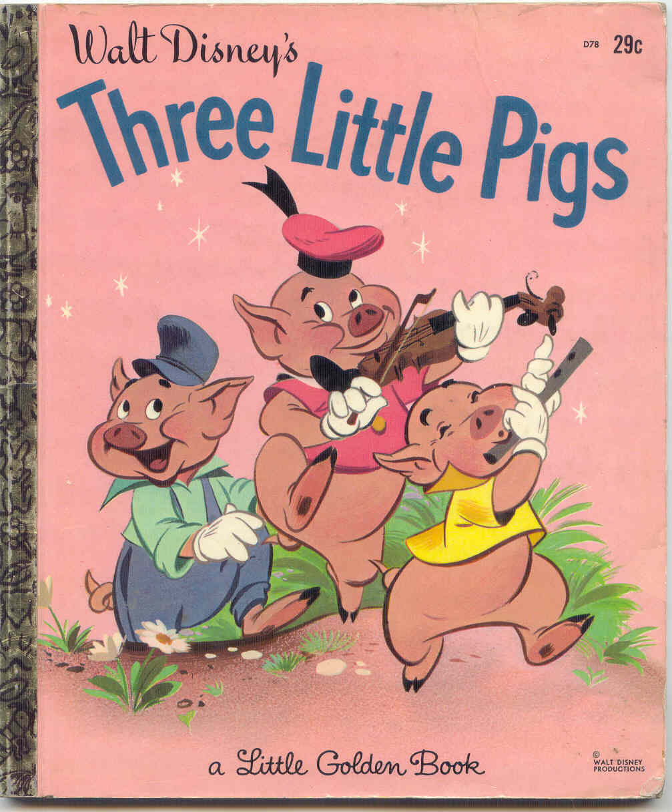
Children’s Writing Overview
Fun, Straight-Forward, Predictable

Slide 6
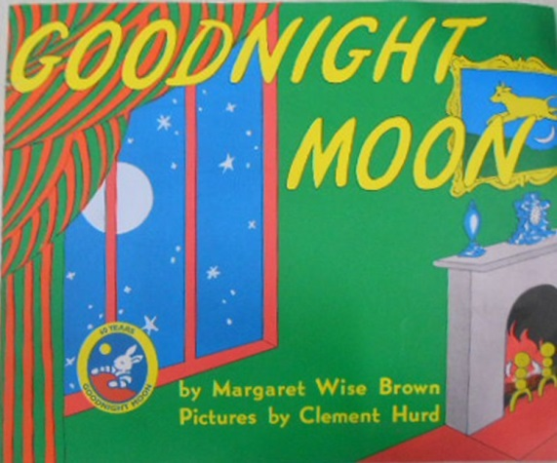
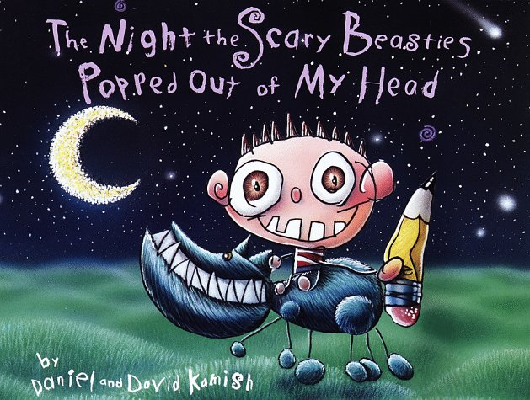
Think Like a Child
Step into a child’s world – issues, circumstances, problems

Slide 7
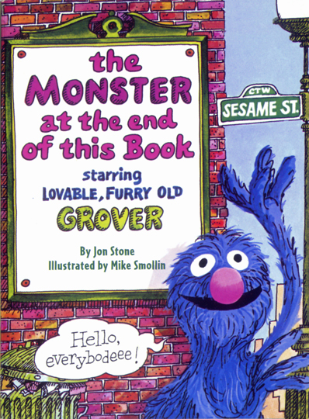
Think Like a Child
Address children’s emotions – funny, spooky, goofy, amazing

Slide 8
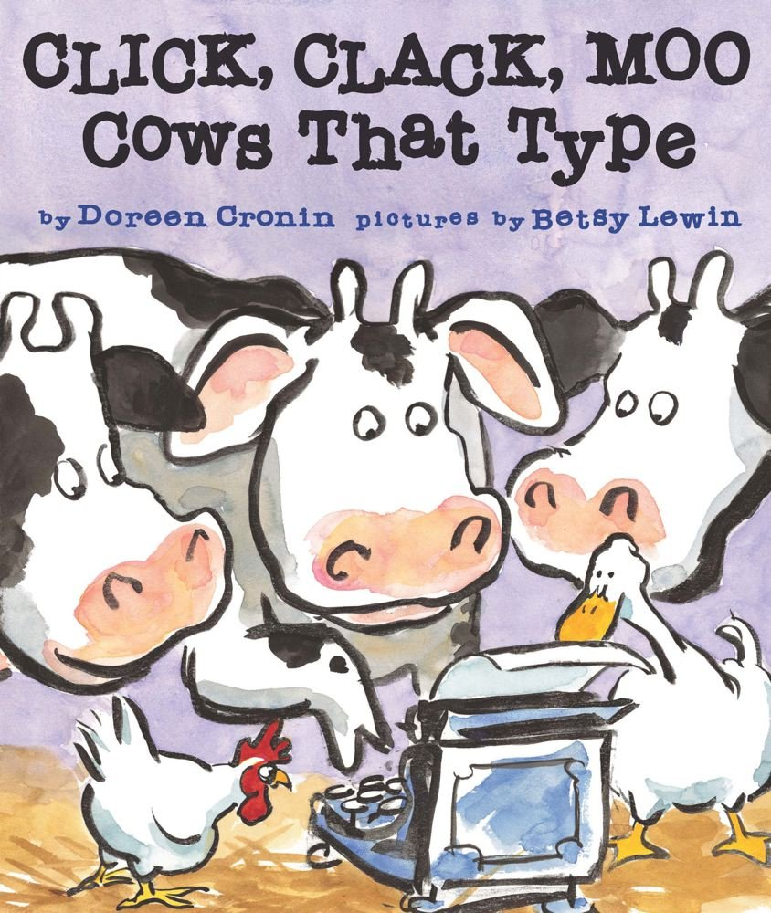
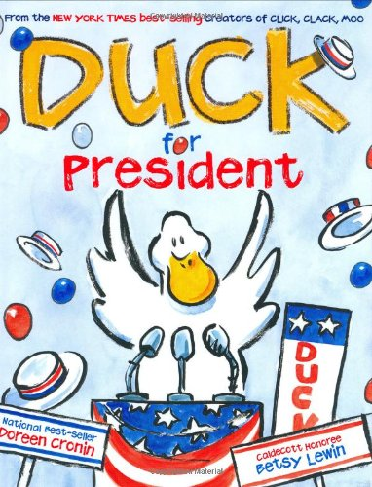
Think Like a Child
Believe the unbelievable

Slide 9
Think Like a Teacher/Parent
What is important to teachers / parents? – Connecting with children

Slide 10
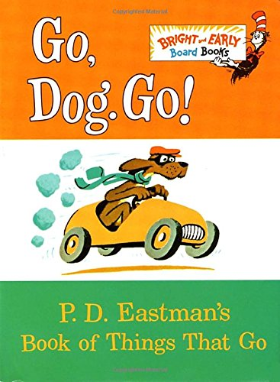
Think Like a Teacher/Parent
What is important to teachers / parents? – Reading, Educational Nuggets

Slide 11
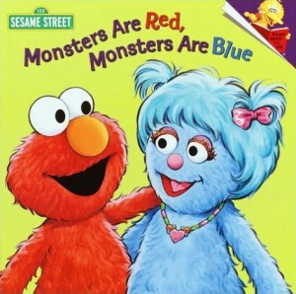
Think Like a Teacher/Parent
What is important to teachers / parents? – Skirt Social Issues/Taboos

Slide 12
Efficient Visual Writing
Select the best words possible
Examples:
“I think I can, I think I can, I think I can.”
Watty Piper, The Little Engine That Could
“A person’s a person, no matter how small.”
Dr. Seuss, Horton Hears a Who
“Today you are You, that is truer than true. There is no one alive who is Youer than You.”
Dr. Seuss, Happy Birthday to You!

Slide 13
Efficient Visual Writing
Can the reader see the pictures without the pictures?
Examples:
“Chicka Chicka Boom Boom.”
Bill Martin, Jr. and John Archambault, Chicka Chicka Boom Boom
“Be still. Listen.
Like you, the Earth breathes.
Your breath is alive with the promise of flowers.
Each time you blow a kiss to the world, you spread pollen that might grow to be a new plant.”
Elin Kelsey, You Are Stardust

Slide 14
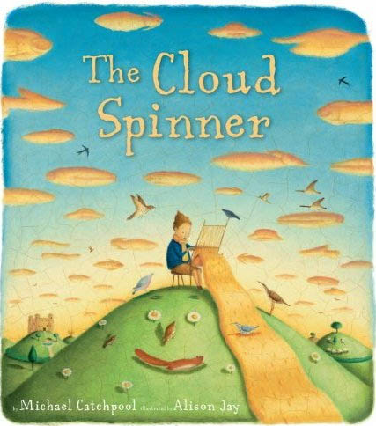
Working with an Illustrator
Match the artist’s style with the story’s theme

Slide 15
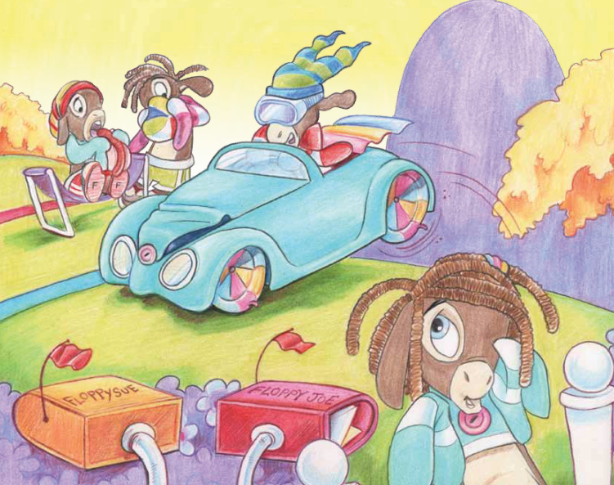
Working with an Illustrator
Communicate with illustrator, page by page – details are important
“Floppies aren’t like people, though some say they are. They all wear Floppy hats and they all drive Floppy cars. They all have Floppy hairdos and they play Floppy games. They eat Floppy hot dogs and they have Floppy names.”
- Frozen Floppies, John Hope

Slide 16
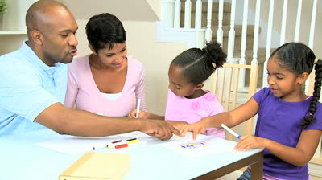
Marketing / Networking
Meet DIRECTLY with parents, teachers, and children
Parenting Groups
School Functions
Events that Benefit Kids

Slide 17
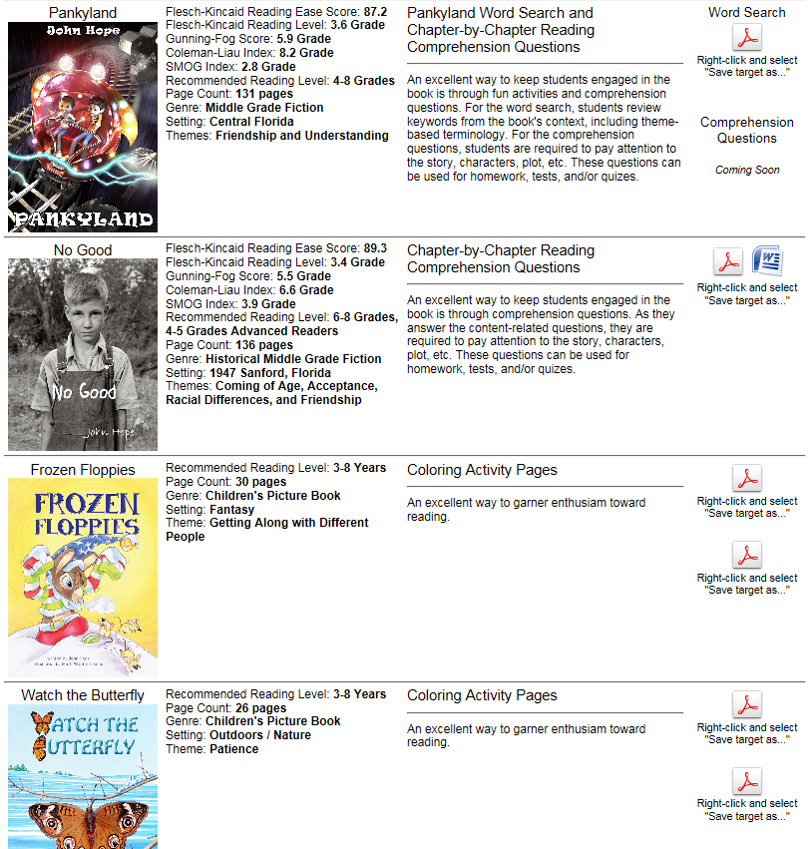
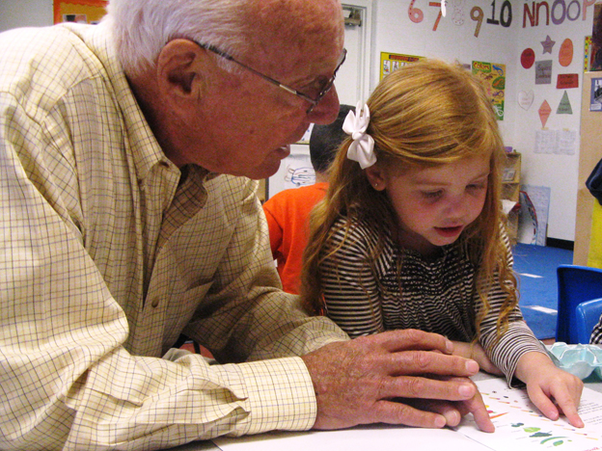
Marketing / Networking
Volunteer – focus your efforts on helping to build your credibility

Slide 18
Children’s Writing that Sells
John Hope
john@johnhopewriting.com
www.johnhopewriting.com
Click on “For Teachers”

