Slide 1
Mastering
Creative Nonfiction Writing Workshop
John Hope

Slide 2
Creative Nonfiction Workshop
Agenda
Creative Nonfiction Definition
Focus and Theme
Characters and Descriptions
10 minute Break
Story Structure
Tell the Truth
Digging into Emotions
Note: Presentation is available: www.johnhopewriting.com

Slide 3
Creative Nonfiction Workshop
Objective
Master tools and techniques for approaching creative nonfiction and writing effectively

Slide 4
Creative Nonfiction Definition

Slide 5

Creative Nonfiction Definition
Using literary techniques to compose a factually accurate story
Accurate setting
Real people
Real events
Compelling
Vivid
Dramatic

Slide 6
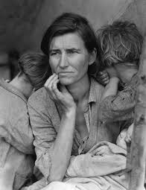
Creative Nonfiction Definition
Example: The Great Depression
The Facts
The Impact
World-wide impact
Lasted from 1929 to 1939
Began after the stock market crash of October 1929
Unemployment in the US rose to 25%

Slide 7
Creative Nonfiction Definition
How is this different than Memoirs?
Memoir
Creative Nonfiction
Personal
Your unique life’s story
Broader appeal
Telling the story of many people

Slide 8
Focus and Theme

Slide 9
Focus and Theme
Usually subtle, harder to grasp than other story elements
What do you want to tell people about ________?
How has ________ changed your and/or others lives?

Slide 10
Focus and Theme
Theme does not have to be simple
Life is not always black and white
  Some of the best themes delve into the gray area of life

Slide 11
Focus and Theme
Establishing a solid focus and theme first will to tell what details to include and what to omit
  Pick a single topic
  Life is filled with details
  What to include is as important as what not to include

Slide 12

Focus and Theme
Example: Explaining the birds and the bees

Slide 13
Focus and Theme
How to Select a Focus and Theme
Step 1: Think about your audience
  What is important to them?
  What do you think they should understand?
  If a personal experience, what is the take away lesson you’ve learned that others could relate?

Slide 14
Focus and Theme
How to Select a Focus and Theme
Step 2: Match your characters’ goals
  What do the people in your story want the most?
  What are their desires?
  What conflict(s) is preventing the characters getting what they want?

Slide 15
Focus and Theme
How to Select a Focus and Theme
Step 3: Build a list
  Write down a list of possible themes.
  Select ONE
    Warning: The more you select, the more watered down the theme will be.

Slide 16
Focus and Theme
How to Select a Focus and Theme
Step 4: Write your manuscript with theme in mind.
  Don’t fret too much with the first draft, just keep the theme in mind as a target.
  Structure scenes and dialog around the theme.

Slide 17
Focus and Theme
How to Select a Focus and Theme
Step 5: Add theme elements during re-writes.
  Think: How can I imply/point to the theme in this scene?

Slide 18

Focus and Theme
Activity: Selecting a Focus and Theme
Event: 9/11 Tragedy
List Themes
  What was important about this?
  What can an individual learn from this?
Possible Focus
  Who should tell this story? (point of view)
  How does this affect your character(s)?

Slide 19

Focus and Theme
Activity: Selecting a Focus and Theme
Event: Having a Baby
List Themes
  What was important about this?
  What can an individual learn from this?
Possible Focus
  Who should tell this story? (point of view)
  How does this affect your character(s)?

Slide 20
Focus and Theme
Once theme is selected, keep it in mind as you develop each scene
Often helps to revisit the theme AFTER manuscript is complete
  Layer theme clues
  Setting, dialog, mood, details

Slide 21
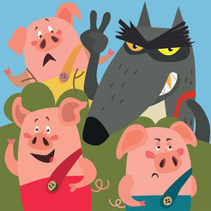
Focus and Theme
Activity: 3 Little Pigs
  What theme/themes are in this story?

Slide 22
Focus and Theme
Activity: 3 Little Pigs
  What theme/themes are in this story?
Taking your time
Working hard
Overestimating yourself
Straw house, Stick house, Brick house
Pigs vs Wolf
“Little pig. Little pig. Let me come in.”
“Not by the hair of my chinny chin, chin.”

Slide 23
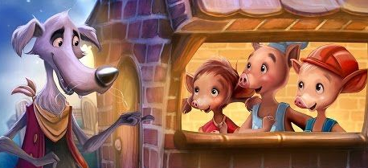
Focus and Theme
Activity: 3 Little Pigs
  What if… the wolf and pigs were friends in the end?
  Possible new theme: Unlikely friends come with understanding
  Changes in plot can change your theme

Slide 24

Focus and Theme
Writing Tip
One common method of telling a Creative Nonfiction piece is to center the story on an object
  Select something of significance
  Follow the history of that object as you weave through lives of your characters
The Red Violin
Based on a historic 1720 Stradivarius violin nicknamed
the “Red Mendelssohn.”

Slide 25
Focus and Theme
The Hammer Story

Slide 26
Characters and Description

Slide 27
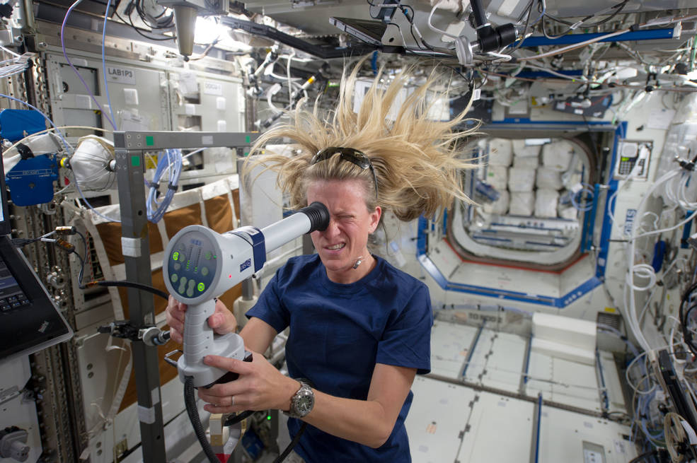

Characters and Description
Creative Nonfiction – story of real people
As a writer – view people as characters

Slide 28
Characters and Description
Characters are the soul of Creative Nonfiction
  The richer the character, the better the story

Slide 29

Characters and Description
#1 Rule of all characters: All characters need to want something that they can’t obtain
If a character doesn’t want something, he/she should not be in your story

Slide 30
Characters and Description
Introducing characters
Mention specific physical characteristics
  40 years old, woman, five foot ten, dirty blonde, rough skin
  Sights, smells, touch
  How does he/she move, talk
  Make use of analogies
Background
  Pepper background information as the story develops
  Avoid info dumps
  Include just enough to get to the next sentence

Slide 31
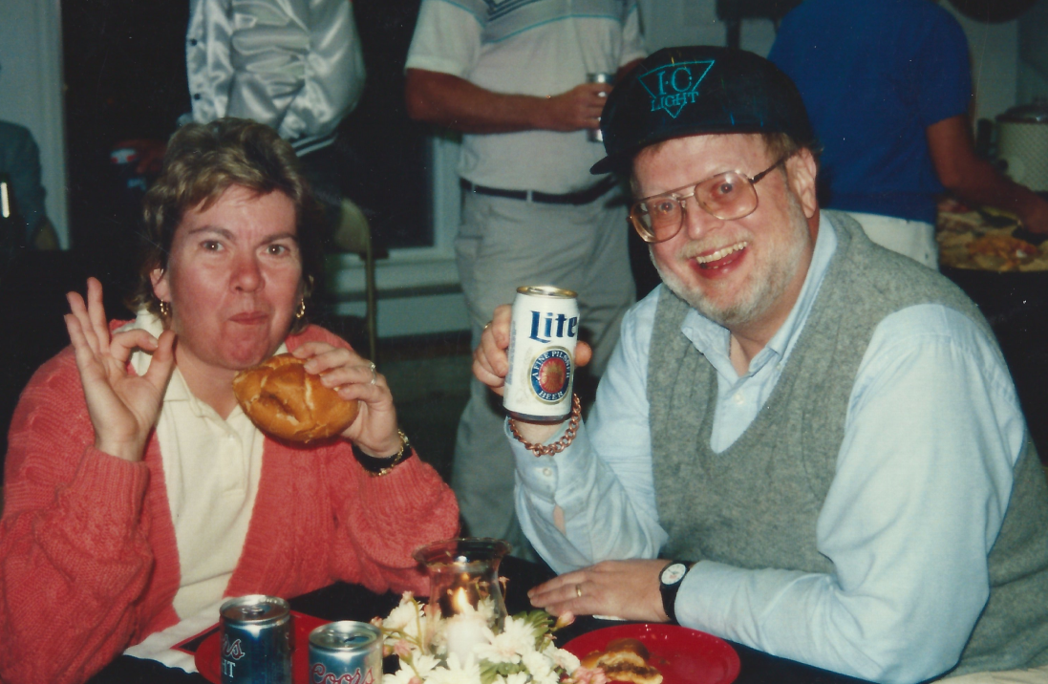
Characters and Description
Uncle Charlie Story

Slide 32

Characters and Description
Activity: Describe a pet as your best friend
What did he look like?
How did he act when he saw you?
What did he smell like?
What did he eat?
Funny moments?

Slide 33
Characters and Description
Character arc
Show how the character is now
Show character enduring / trying to resolve conflict
Show how the character is different afterwards
Can be done for ALL main characters

Slide 34
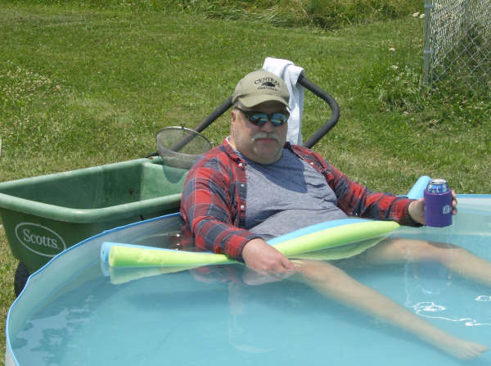
10 Minute Break

Slide 35
Story Structure

Slide 36
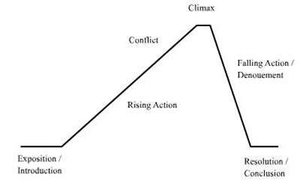
Story Structure
All stories follow some sort of trajectory
  Introduction of characters
  Rise and Fall of action / conflict
  Resolution
Creative nonfiction typically has a lesson / moral / take away by the end

Slide 37
Story Structure
The keys to story structure
  Introduce the MAIN conflict as soon as possible
  Every scene should progress the plot and reveal character
    Fill in backstory as the story progresses
  Resolve the MAIN conflict

Slide 38
Story Structure
Example (a joke):
Uber passenger tapped the driver on the shoulder to ask him a question.
The driver screamed, lost control of the car, and nearly hit a bus.
The passenger smiled sheepishly. “I didn't realize a little tap would scare you so much.”
The driver caught his breath. “Not your fault. For weeks, I’d been driving a hearse.”

Slide 39
Story Structure
Character 1
Character 2
Where they meet is at the center of our story

Slide 40
Story Structure
Story Boarding – Decide how to tell the story
Dave asks Alice to a 6th Grade Dance
Dave meets Alice in 3rd Grade
Alice goes out with Dave’s best friend, Tom
Tom and Dave fight
Dave, Tom, and Alice are friends
Alice and Dave kiss

Slide 41
Story Structure
Start with a Hook
  First sentences are often the hardest
  Jump into the story, make the reader want to continue
All this happened, more or less. —Kurt Vonnegut, Slaughterhouse-Five (1969)
It was a pleasure to burn. —Ray Bradbury, Fahrenheit 451 (1953)
Once upon a time, there was a woman who discovered she had turned into the wrong person. —Anne Tyler, Back When We Were Grownups (2001)

Slide 42
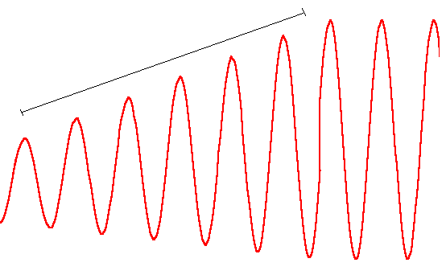
Story Structure
Pacing
Increase Intensity
Tense Moments
Reflection / Description

Slide 43
Story Structure
Factors that affect pacing
  Amount of elaborate descriptive language verses quick, blunt words
  Number of words used
  Criticality of the conflict
  The amount of time that passes

Slide 44

Story Structure
Example: The Cat in the Hat
Kids are bored
Cat does some juggling, frightens the fish
Brings Thing 1 and 2, both destroy the house
Mom approaches
Cat leaves with Thing 1 and 2
Cat returns with a machine that cleans up at the last moment
Mom arrives

Slide 45
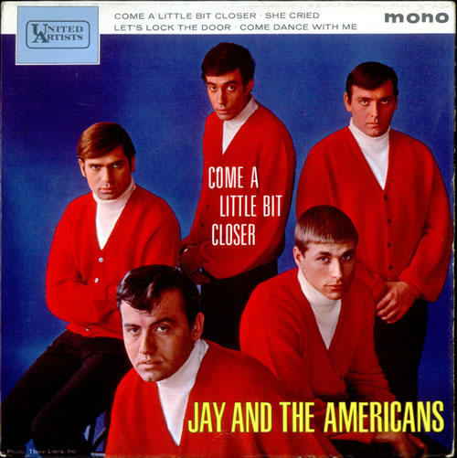
Story Structure
Example: Come a Little Bit Closer
Songwriters: Tommy Boyce / Wes Farrell / Bobby Hart
Come a Little Bit Closer lyrics © Morris Music, Inc

Slide 46
Story Structure
Come a Little Bit Closer, part 1
In a little café just the other side of the border
She was just sitting there givin' me looks
that made my mouth water
So I started walking her way
She belonged to bad man Jose
And I knew, yes I knew I should leave
When I heard her say, yeah
"Come a little bit closer
You're my kind of man
So big and so strong
Come a little bit closer
I'm all alone and the night is so long"

Slide 47
Story Structure
Come a Little Bit Closer, part 2
So we started to dance. In my arms, she felt so inviting.
And I just couldn't resist, just one little kiss, so exciting.
Then I heard the guitar player say
"Vamos, Jose's on his way"
Then I knew, yes I knew I should run
But then I heard her say, yeah
"Come a little bit closer
You're my kind of man
So big and so strong
Come a little bit closer
I'm all alone and the night is so long"

Slide 48
Story Structure
Come a Little Bit Closer, part 3
Then the music stopped, when I looked the cafe was empty
Then I heard Jose say, "Man, you know
you're in trouble plenty."
So I dropped my drink from my hand
And out through the window I ran
And as I rode away
I could hear her say to Jose, yeah
"Come a little bit closer
You're my kind of man
So big and so strong
Come a little bit closer
I'm all alone and the night is so long"

Slide 49
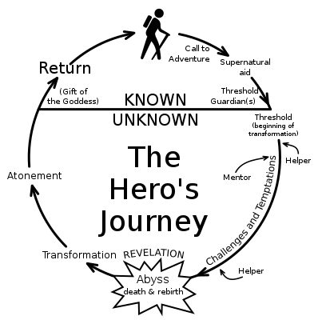
Story Structure
Activity: The Hero’s Journey
Select a personal journey in your life
Step through each piece of the diagram on the right
Tell your story

Slide 50
Tell the Truth

Slide 51
Tell the Truth
Gather the facts first
  Setting
  Characters
  Dates
  Circumstances
Never contradict facts

Slide 52

Tell the Truth
Research can be fun
  Be a detective, uncover facts
  Relate facts together
Remember: People are people no matter what time period you are researching

Slide 53
Tell the Truth
Facts will likely have holes
  Exactly what was said
  Sometimes, order of events are in question
  The exact cause of events may be in question
Determine plausible answers that fill in the gaps

Slide 54
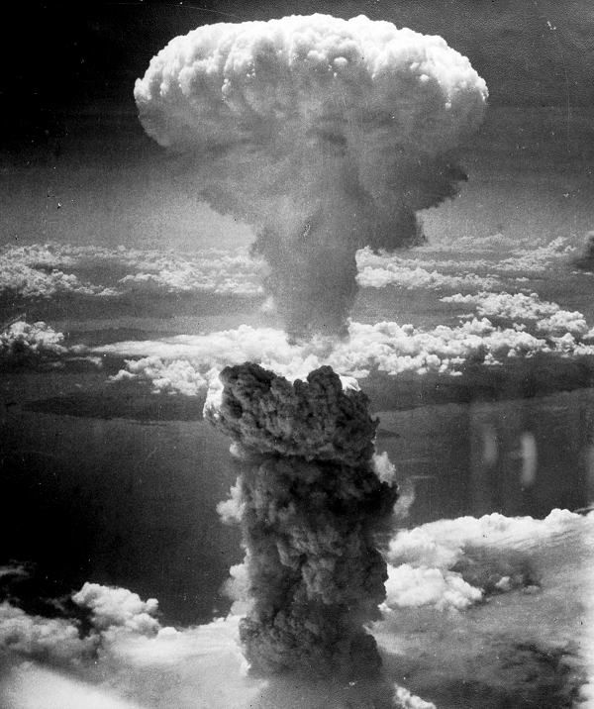
Tell the Truth
Example 1: The US dropped two atomic bombs on Japan at the tail end of WWII.
Question: Why?
Various historical rationale and many people involved

Slide 55
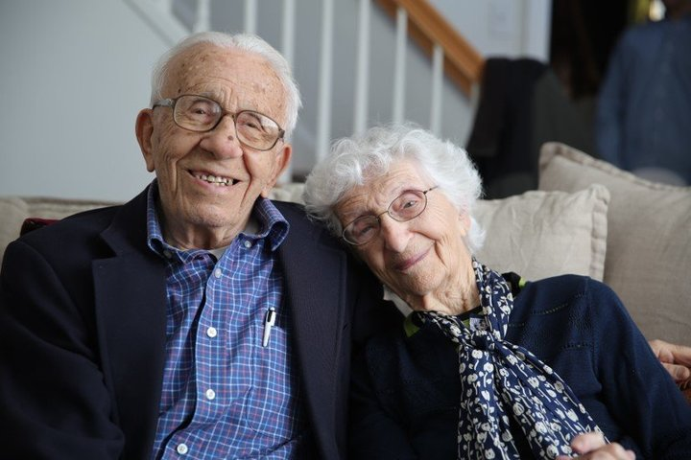
Tell the Truth
Example 2: How your parents/grandparents fell in love.
Question: What were their exact conversations?
Include their mannerisms, sayings, sense of humor, maybe small phrases – guess what they might have said
Be true to their characters

Slide 56


Tell the Truth
Different Perspectives
The same story can be told from different perspectives
  Completely change good guys and bad guys
Vietnam War
American War

Slide 57

Tell the Truth
Different Perspectives
Activity 1: Tell the story of each kid
Wants?
What’s his/her conflict?

Slide 58

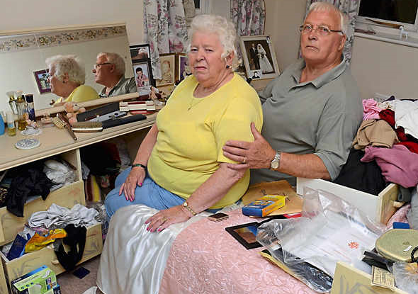
Tell the Truth
Different Perspectives
Activity 2: Burglar vs Victims
Wants?
What’s his/her conflict?

Slide 59
Digging into the Emotions

Slide 60
Digging into the Emotions
Emotions are tricky things
  SHOW, don’t tell!
Avoid flat statements of emotion:
  He felt sad.
  Happiness engulfed him.
  He was filled with joy.
Showing is far more powerful
  He pet his beloved Jack Russell for the last time as the nurse plunged the needle in. His eyes closed.

Slide 61
Digging into the Emotions
Use all appropriate emotions, including…
  Humor (wit, funny situations, etc.)
  Anger
  Frustration
Be specific with actions and reactions
  Rather than: Clair watched him cried.
  Instead: Clair touched the tissue to his damp face, the way Mom used to touch her face as a child.

Slide 62
Digging into the Emotions
For Creative Nonfiction, especially, emotions can be hard and painful
  Be bold
  Be fearless
#1 Goal: Make the reader feel what you/your characters feel
  Guide them through the experiences
Great works dig into emotion

Slide 63

Digging into the Emotions
Example: Night
  by Elie Wiesel
Novella that masters emotions subtly yet with extreme impact

Slide 64

Digging into the Emotions
Example: Angela’s Ashes
  by Frank McCourt
A rollercoaster of emotions
  Humor
  Excitement
  Anguish

Slide 65

Digging into the Emotions
Example: I Know Why the Caged Bird Sings
  by Maya Angelou
Personal journey, but one that’s relatable to many
  Racism
  Sexual Abuse
  Finding One’s Self

Slide 66

Digging into the Emotions
Activity: Sharing emotional moments

Slide 67

Creative Nonfiction Workshop
Thank you!
Presentation posted here:
www.johnhopewriting.com

