Slide 1
Deep Editing Short Stories
Good to Great
Presenter
John Hope

Slide 2
Deep Editing Short Stories:
Good to Great
Audience and Theme
Conflict, Conflict, and more Conflict
Ups and the Downs
Heroes and Villains
Symbolism
A Story’s Success

Slide 3
Audience and Theme

Slide 4
Audience and Theme
What are you trying to tell people?

Slide 5
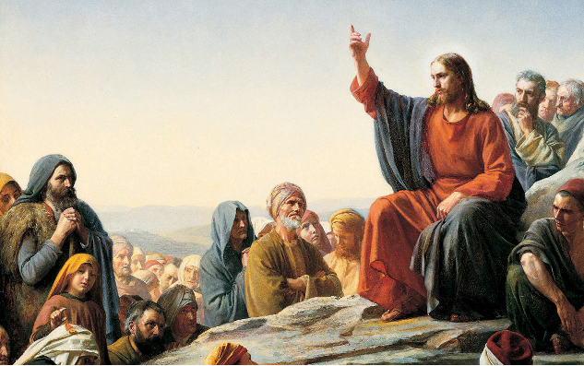
Audience and Theme
Storytelling is powerful

Slide 6
Audience and Theme
Identify your audience
  What is important to them?
  What do they understand?
  Where are their emotions?

Slide 7
Audience and Theme
Example: Science Fiction
  Typically “nerdy” people are attracted to Science Fiction
  Characteristics of “nerdy” people:
    Difficulty with relationships
    Enjoys creative alone time
    Finds intellectual questions fascinating
    Loves underdog stories

Slide 8
Audience and Theme
Identify your theme
  What truths do you want to say to your audience?
  Okay if truth is only true from a certain point of view.
  Be bold.

Slide 9
Audience and Theme
Theme Examples
  The Lottery, Shirley Jackson
    Stark, inhumanity of community
    Sacrifice
  The Veldt, Ray Bradbury
    Disconnected parenting
    Fragileness of life

Slide 10
Audience and Theme
Incorporating theme after the fact
  Review scene after scene, allude theme in each one

Slide 11
Audience and Theme
Example: Kids need to learn how to work hard
  Show benefits of hard work
  Show the follies of people/kids who don’t work hard
  Show how people can change with hard work
  Show different avenues of hard work

Slide 12
Conflict, Conflict, and More Conflict

Slide 13
Conflict, Conflict, and More Conflict
Conflict is our friend
  Expose as quickly as possible
  Layer conflict
  Intensify conflict

Slide 14
Conflict, Conflict, and More Conflict
Expose as quickly as possible
  Mary wakes up.
  Mary takes a shower.
  Mary drinks her coffee.
  Police come to her door and arrest her husband for tax evasion.
  Mary panics and fights with the police.
  In the struggle, police shoot husband.
  Mary cries.

Slide 15
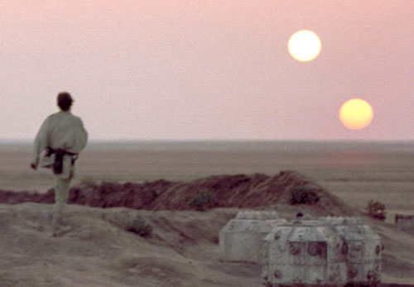
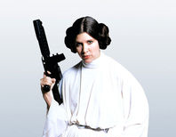
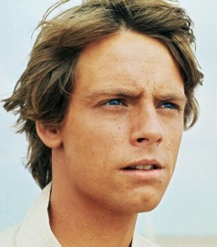
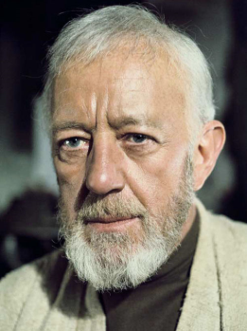
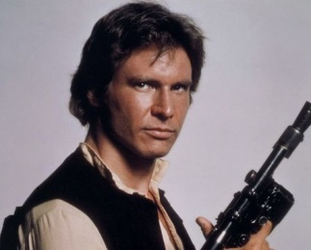
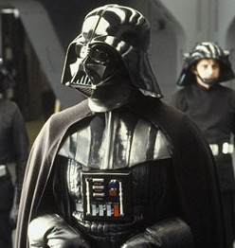
Conflict, Conflict, and More Conflict
Desires Adventure
Layer Conflict, example 1
Seeks Foxy Princess
Luke Skywalker
Fascinated by Jedi Tales
Bad Guy Wants Him
Clashes with Cynical Hero

Slide 16
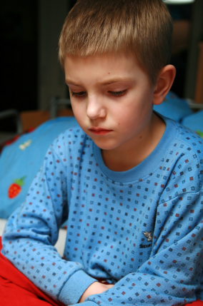

Conflict, Conflict, and More Conflict
Layer Conflict, example 2
The Dance
5-year-old David
15-year-old Camden
Wants to go to the dance with older brother, has to stay home with Grandma
Goes to dance, gets heart broken by girl, comes home

Slide 17
Conflict, Conflict, and More Conflict
Layer Conflict, example 2
David’s initial concern for this big brother
I crawl up Camden’s bed, slide under the covers next to him, and rest my head on his bare chest. The thumping of his heart beats against my face. I shiver.
Camden asks, “What’s wrong with you?”
I say, “Bad dream. A bunch of bad people. They look scary.”
“Dreams won’t hurt you.” He wraps his arm around and pats the side of my leg. He sniffles and I feel the shake of his body. I look up and he is wiping his face with his other hand.
“What’d you eat at the dance?”
“Just junk.”
I huff. “I had SpaghettiOs.”
His voice shakes as he speaks. “I like SpaghettiOs.”
“Camden?”
“Yeah?”
“I never want to go to a dance.”
He pats me again. “Na. They’re not bad. Just sometimes… sometimes people are mean.”
Camden’s concern for his little brother
David’s fear of what might have happened at the dance
David jealous of not being able to eat junk food
Camden upset about the events at the dance
Camden wishes he was five years old
Camden concern for his little brother’s fears

Slide 18
Conflict, Conflict, and More Conflict
Intensify Conflict
Initial Conflict
Things Get Worse
Things Get Worse
Things Get Worse

Slide 19
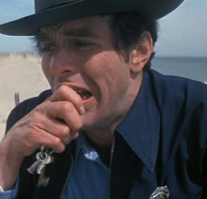
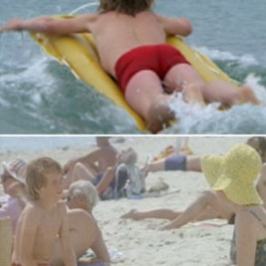
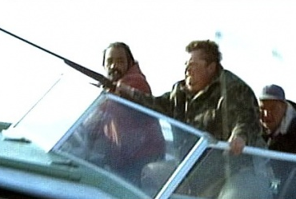
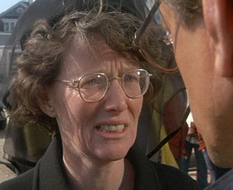
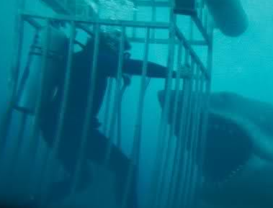
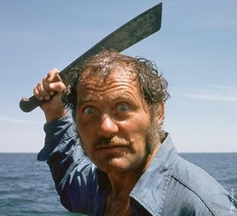
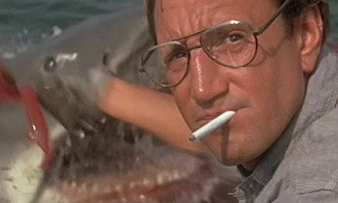
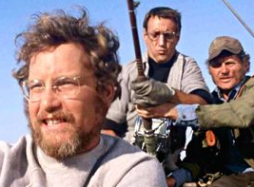
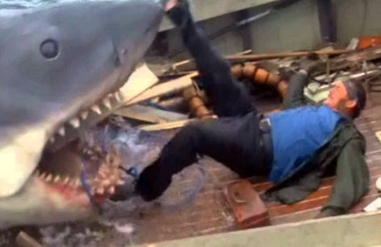
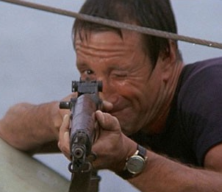
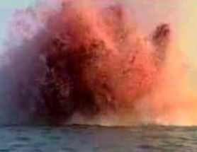
Conflict, Conflict, and More Conflict
Intensify Conflict, Example: Jaws (1975)

Slide 20
Ups and Downs

Slide 21
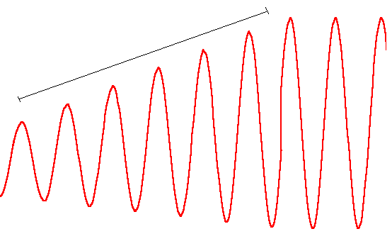
Ups and Downs
Pacing
Increase Intensity
Tense Moments
Reflection / Description

Slide 22
Ups and Downs
Factors that affect pacing
  Amount of elaborate descriptive language versus quick, blunt words
  Number of words used
  Criticality of the conflict
  The amount of time that passes

Slide 23
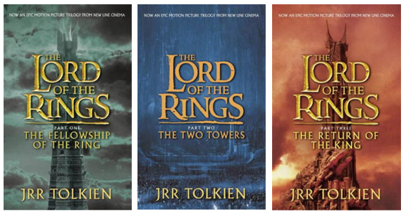
Ups and Downs
Example 1: Lord of the Rings
Very slow, lots of explanation
Clashing of good verses evil intensifies
Entire world at war, series climax

Slide 24
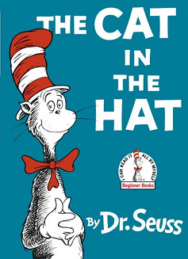
Ups and Downs
Example 2: The Cat in the Hat
Kids are bored
Cat does some juggling, frightens the fish
Brings Thing 1 and 2, both destroy the house
Mom approaches
Cat leaves with Thing 1 and 2
Cat returns with a machine that cleans up at the last moment
Mom arrives

Slide 25
Ups and Downs
Tips to decrease pace:
  Include specific descriptions
  Flashbacks / reflections / comparisons
Tips to increase pace:
  Use descriptive verbs
  Skip boring and/or understood scenes
  Remove gratuitous elements
  Let the events explain how people feel/think

Slide 26
Heroes and Villains

Slide 27
Heroes and Villains
Readers love to have someone to root for and someone to hate
Good versus evil is universally understood
Good guys are just as important as bad guys

Slide 28
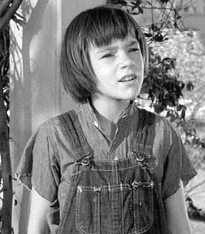
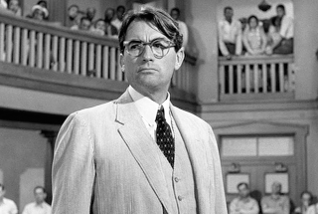
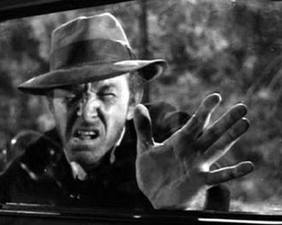
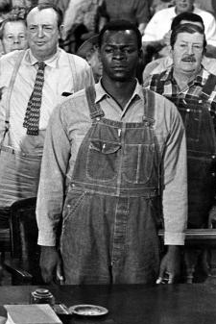
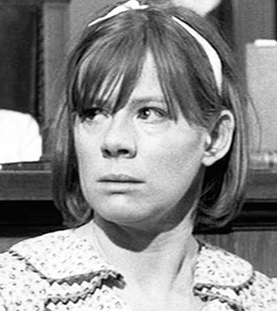
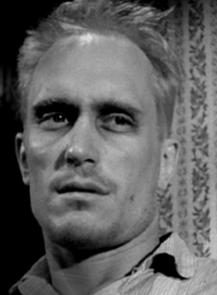
Heroes and Villains
The good and the bad

Slide 29
Heroes and Villains
Heroes: What readers like in characters
  Has flaws
  Humble
  Good character (dependable / keep promises / honest)
  Live by morals / standards
  Helpful / compassionate (esp. for certain people)
  Funny / sense of humor
  Courageous, yet shows fear
  Relatable goals
  Down to Earth / level-headed / even-tempered
  Smart
  Cool (esp. in tense moments)

Slide 30
Heroes and Villains
Villains: What readers don’t like in characters
  Perfect
  Liar / undependable / carelessly breaks promises
  Brags / sees themselves as superior
  Unsportsmanlike / unfair
  Self-serving
  Not funny / bad sense of humor
  Hidden cowards
  Unworthy goals
  Extreme behavior / mood swings
  Bullies others
  Whines and complains
  Panics under pressure

Slide 31
Heroes and Villains
Heroes
  Expose/highlight likeable characteristics
Villains
  Expose/highlight despicable characteristics
In both cases…
  Subtle clues go a long way
  BE TRUE TO ALL CHARACTERS

Slide 32
Symbolism

Slide 33
Symbolism
The glitter that makes a story shine
Highlights themes and story elements to give them more impact
Should not require explanation
Requires a strong story first

Slide 34
Symbolism: Metaphors / Analogies
Avoid clichés
  Ex: “Prettier than a rose.”
The more vivid (and specific) the better
  Ex: “The wheel's spinning, but the hamster's dead.”
Be consistent with the character making the comparison
  Ex: (from a boy in rural America) “The man was fatter than a pregnant cow.”

Slide 35
Symbolism: Visual Reminders
Objects that help recall memories
  Ex: Stuffed animal / doll in an elderly mother’s hand may remind her of her children when they were young – or when she was young
Objects that imply something deeper
  Ex: (The Great Gatsby) The billboard eyes of Dr. T.J. Eckleburg = sees through the dishonesty -> loss of loss of morality / spiritual values in America

Slide 36
Symbolism: Visual Reminders
Use elements that surround the character(s)
  Common things that character sees everyday now has new meanings due to circumstances
  Character(s) sees things in a different light
  Character(s) compares things with other elements/experiences

Slide 37
Symbolism: Double Meanings
“Marriage is a fine institution, but I'm not ready for an institution.” – Mae West
“Whenever I feel blue, I start breathing again.” – L. Frank Baum
“The only thing we don't have a god for is premature ejaculation... but I hear that it's coming quickly.” ― Mel Brooks

Slide 38
Symbolism: Parallel Stories
Duplicate lessons or themes that multiple characters experience
  Ex:
    A girl loses her friend’s trust by plagiarizing her homework.
    The girl’s mom loses the trust of her work associates by taking credit for her peers’ work.

Slide 39
Symbolism: Things to Avoid
Will your implications be appropriate for your audience?
  Ex: A bully taunts a smaller boy by grabbing a small lizard, pulling off its tail, and waving the writhing tail in the smaller boy’s face.
  Feedback (from a teacher): “This would not be accepted in the school system since this is animal cruelty and such behavior is seen as roots to serial killers.”

Slide 40
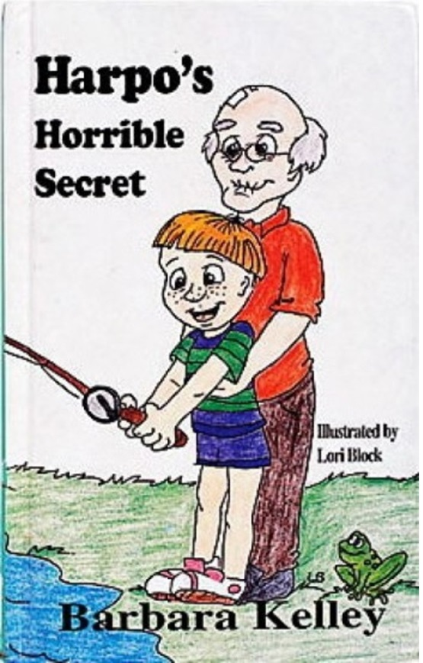
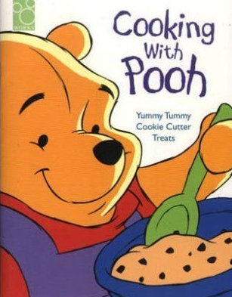
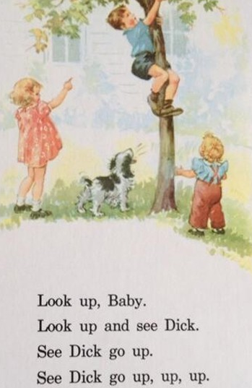
Symbolism: Things to Avoid
Other unintentional implications

Slide 41
A Story’s Success

Slide 42
A Story’s Success
In all cases, success depends on:
  Getting the right story
  To the right person
  At the right time

Slide 43
A Story’s Success
The Right Story to the Right Person
Know your audience
  Who is buying stories in your genre?
  Who is judging/scoring your story?
  Has this story already been told?
  People love stories with which they can connect.

Slide 44
A Story’s Success
The Right Story to the Right Person
Research Agent / Publisher’s listings / catalogs
  How does your story fit?
  Does it complement other stories?

Slide 45
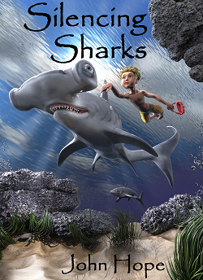
A Story’s Success
The Right Story to the Right Person
Story Characters and Elements
  Seek readers who have a connection with specific story characters and/or elements
Example:
13-year-old boy
Deaf protagonist
Boy is bullied
Shark conservation
Adventure / fantasy

Slide 46
A Story’s Success
At the Right Time
How do you guarantee that a story will reach people at the right time?
  Stay in touch with what’s popular – trends
  Talk to / listen to your audience
  There’s no guarantee

Slide 47
A Story’s Success
At the Right Time
Best thing you can do:
  BE PERSISTENT
Spend time doing
Set daily / weekly goals
Steadily gain success

Slide 48
A Story’s Success
At the Right Time
Personal experience:
  Royal Palm Literary Awards
Year | Number of Submissions | Number of Awards
2012 | 8 | 0
2013 | 5 | 2
2014 | 6 | 2
2015 | 8 | 1
2016 | 7 | 5
2017 | 5 (so far) | TBD
Totals | 39 | 10

Slide 49
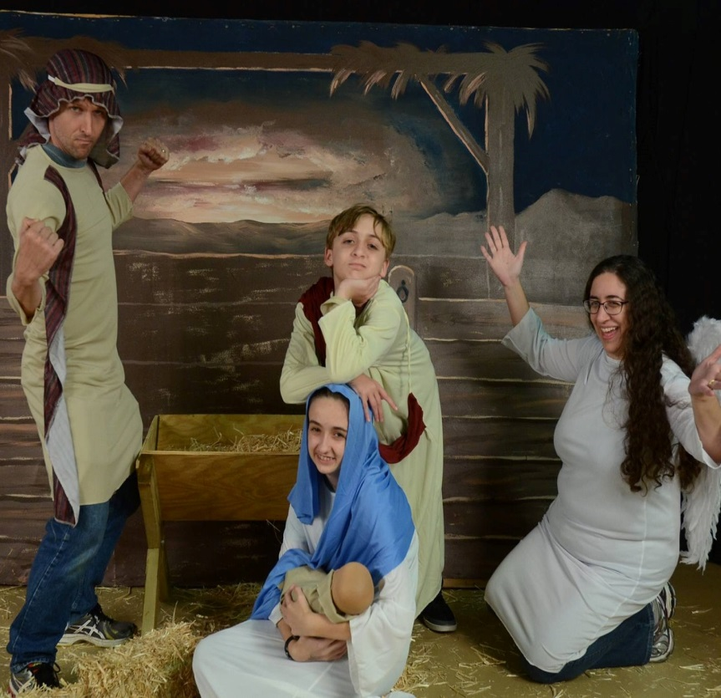
Deep Editing
Short Stories:
Good to Great
www.JohnHopeWriting.com
Click on “For Teachers”

