Slide 1
How to Make Money Writing
John Hope

Slide 2
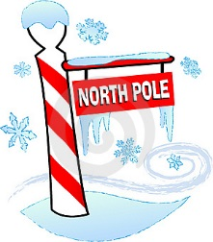
The Story of the A-B-C-D “Hot Dog” Friends
Amy
Betty
Carol
Debbie
India
Nepal
Australia

Slide 3
Amy’s Hot Dog Business
Problem #1: Hot dogs contains rat droppings
Solution #1: Amy upgrades to all-beef hot dogs
Problem #2: People of India don’t like beef
Solution #2: Amy switches to all-turkey hot dogs
India

Slide 4
Amy’s Hot Dog Business
Amy’s Lessons
Quality
Know Your Customers
India

Slide 5
Betty’s Hot Dog Business
Problem #1: Nepalese people don’t know what hot dogs are
Solution #1: Betty tours the country, sharing hot dogs and hot dog information with lots of people
Problem #2: Nepalese people must hike the Himalayan Mountains to buy hot dogs
Solution #2: Betty opens a chain of hot dog restaurants throughout the country
Nepal

Slide 6
Betty’s Hot Dog Business
Betty’s Lessons
Advertising / Networking
Make Product Accessible
Nepal

Slide 7
Carol’s Hot Dog Business
Problem: Australians LOVE hot dogs so much, Carol keeps running out
Solution: Carol sets up a network of hot dog-producing factories and keeps a daily quota of hot dogs
Australia

Slide 8
Carol’s Hot Dog Business
Carol’s Lesson
Work Hard to Produce
Australia

Slide 9
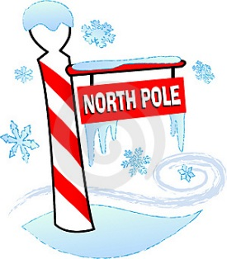
Debbie’s Hot Dog Business
Problem: Initially discovers there are not too many people to buy hot dogs at the North Pole.
Solution: She gets lucky. Christmas elves pop out and buy lots of hot dogs. Santa gives Debbie a multi-million dollar contract to produce hot dogs for his elves for the next 100 years.

Slide 10
Debbie’s Hot Dog Business
Debbie’s Lesson
Be Lucky

Slide 11
Hot Dog Friends
Lessons Learned
Quality
Know Your Customers
Advertising / Networking
Make Product Accessible
Work Hard to Produce
Be Lucky

Slide 12
Who Makes Money in Writing Industry?
Well-Established Writers
People who already have a fan-base and best-sellers
Editors / Publishers
Those who get paid to help writers and/or make money from writers
Specialized and peripheral companies
Printers, advertisement agencies, lawyers, online stores

Slide 13
Make Money Writing
To make money, handle writing as a business
Art = Creative, From the Heart, Warm
Business = Organized, Wise Discussion-Making, Cold

Slide 14
How to Run a Writing Business
Step 1: Create a business plan
Outlines how business will be handled
Plan for near-term investment and long-term gain
Organizes yourself
What are you planning to do?
How are you going to do it?
Short term / long term goals?
Weaknesses / Strengths?
Look for “Start Up Business Plan”

Slide 15
How to Run a Writing Business Business Plan Example
John’s Goals
Artist Goal
Financial Goal
John’s Jobs
Writer
Publisher
Speaker
John’s Plan
Schedule – DEADLINES
Budget
Structure

Slide 16
How to Run a Writing Business
Next, Learn from the Hot Dog Friends
Quality
Know Your Customers
Advertising / Networking
Make Product Accessible
Work Hard to Produce
Be Lucky

Slide 17
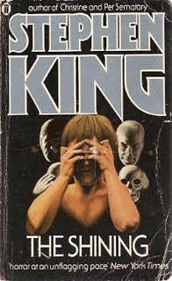
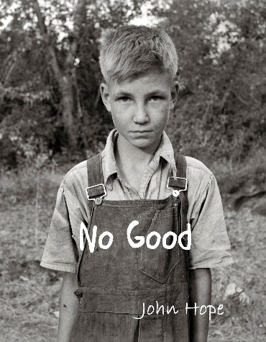
Writing Business: Quality
Writing Critique Groups
Classes / Writing Workshops
Talk to / Meet Good Writers
Write and Re-write
READ, READ, READ
Inspiration could come from anywhere
Example:

Slide 18
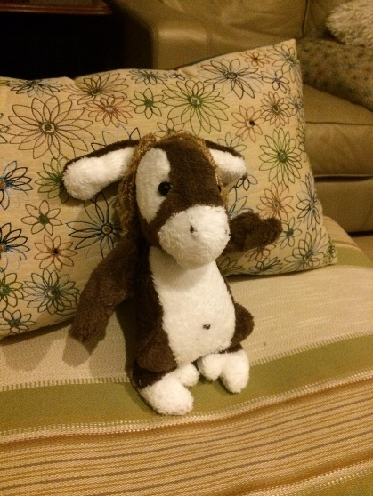
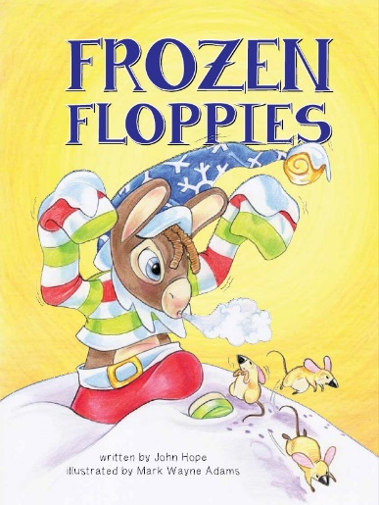
Writing Business: Know Your Customers
Read books in your genres
Talk to / Meet people who read the books you write
What does your audience want?
Fun Fantasy
Kid-Friendly Cuteness
Series of Stories
Example:
- vs -
Make Your Own Floppy
Game / Merchandising

Slide 19
Writing Business: Advertising / Networking, 1
Website / Blog
Need a place to send people
Website Hosting (requires some web knowledge)
Wordpress, Blogger (Google)
Author Central (Amazon)
Advertising companies
Ads average 10% effective

Slide 20
Writing Business: Advertising / Networking, 2
Freebees – promoting / advertising you and your books
Bookmarks, Flyers, Calendars (Uprinting.com, etc)
Coloring pages, word searches
Promotions
Free / Discounted books
Attend book fairs / other events - Book Prizes

Slide 21
Writing Business: Advertising / Networking, 3
Book Reviews
Invaluable way of drawing attention to your book
Notable reviewers
Local / National Newspaper, Goodreads.com, etc
Give out copies of books with the promise they’d write a review
Writing Contests / Awards
Sometimes hard to win / attend
Can be very attractive if you win

Slide 22
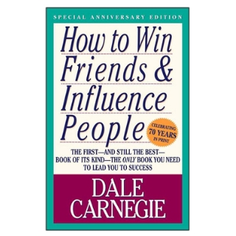
Writing Business: Advertising / Networking, 4
Mailing list
iContact.com, MailChimp.com
Start a list by asking friends / existing fans
Give option to opt out
Periodical newsletter
Email / website
Attend writers conferences / book conferences
Meet people

Slide 23
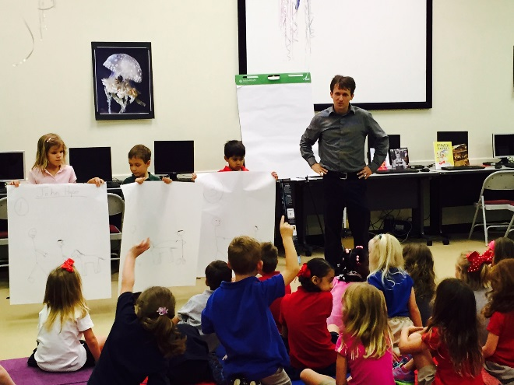
Writing Business: Advertising / Networking, 5
World’s Economy
God’s Economy
- vs -
Buy Low, Sell High
The More You Give, the More You Get
Networking

Slide 24
Writing Business: Make Product Accessible, 1
Again, need a website
List your books, links to read / buy
Add “Contact” page to allow people to ask questions / requests
Hardback, paperback, eBook, audiobook
The more formats the better

Slide 25
Writing Business: Make Product Accessible, 2
Distribution (publishers’ superpower)
Bookstores
Big chains are dying
Local, small shops are not
Amazon and Barnes and Noble websites
CreateSpace, Kindle Direct Publishing, Nook Press

Slide 26
Writing Business: Make Product Accessible, 3
Book Fairs
Check for invites for local authors
Never hurts to ask
Book Signings
Find locations will a lot of traffic
Find your audience
Give Presentations
Offer signed copies of all books purchased

Slide 27
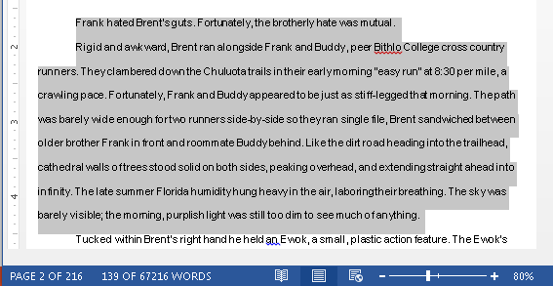
Writing Business: Work Hard to Produce, 1
Set daily word count goals
Keep a “Word Count” log / journal
Balance with attending conferences / meeting with friends

Slide 28
Writing Business: Work Hard to Produce, 2
Find a writing spot
Don’t wait for inspiration
Let feelings follow actions
Finish as quickly as possible

Slide 29
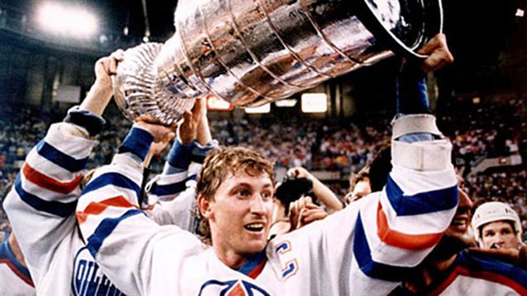
Writing Business: Be Lucky
ALL successful writers have a lucky break story
Try and try and try and try and try
“You miss a hundred percent of the shots you don’t take.” - Wayne Gretzky

Slide 30
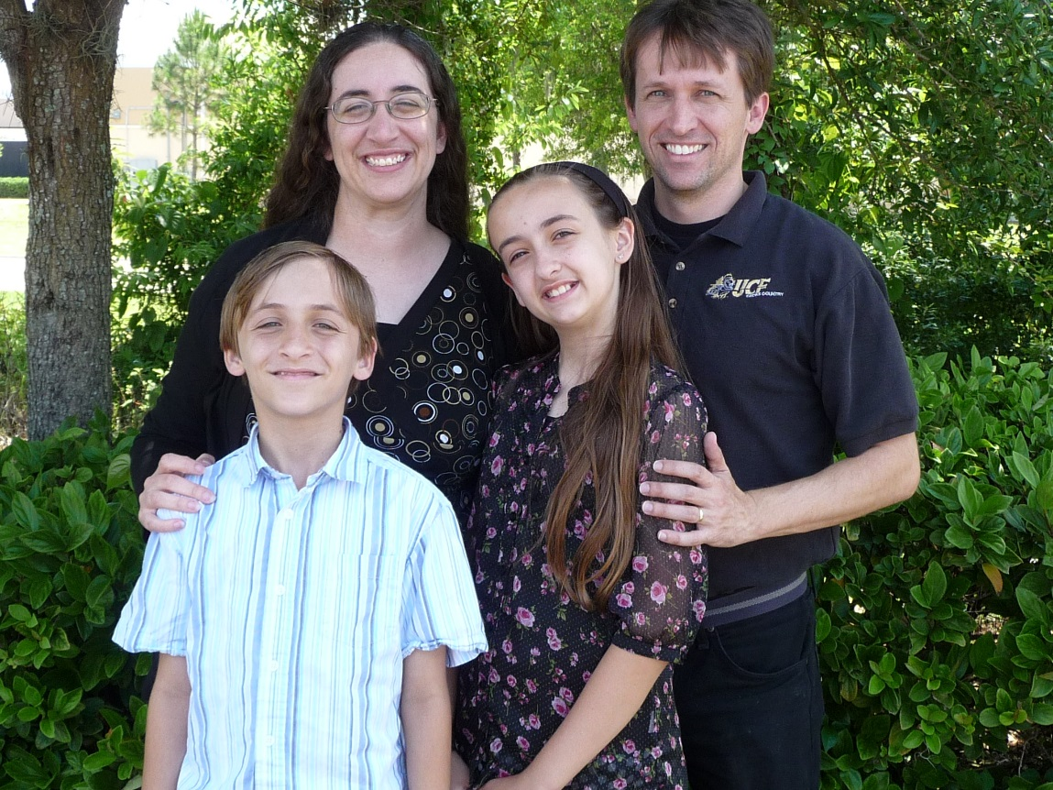
How to Make Money Writing
Insert inspirational story here

Slide 31
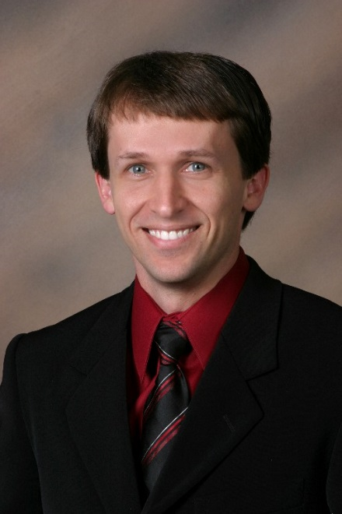
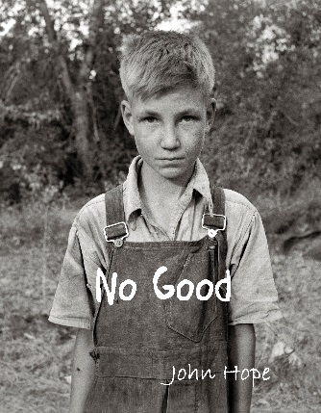
How to Make Money Writing
john@johnhopewriting.com
Questions?
Coming
Sept 2015

