Slide 1
Short Story Workshop
John Hope

Slide 2
Short Story Workshop Agenda
Writing Overview
The Short Story Structure
Characters
Conflict
BREAK
Description and Dialog
BREAK
The Dreaded Re-write
Summary
9:00am – 10:30am Teach
10:30am – 10:45am Break
10:45am – 12:00pm Teach
12:00pm – 1:00pm Lunch
1:00pm – 2:15pm Teach
2:15pm – 2:30pm Break
2:30pm – 3:45pm Teach
3:45pm – 4:00pm Closing

Slide 3
Writing Overview

Slide 4
Writing Overview
The rules of writing (from this course and others)
  Listen to them
  Consider them
  Try them
  Then, break the rules
Key to excellent writing: Give your story what it needs

Slide 5
The Short Story Structure

Slide 6
The Short Story Structure
What defines a short story?
  Often between 1k to 5k words, less than 20k
  Contains a COMPLETE story
    Main conflict resolution
    Character arc
  Rich with scene and character description and dialogue
RPLA Guidelines
  Short fiction has many of the elements of a novel, including character, setting, plot, conflict, resolution, climax, dialogue, protagonist, and antagonist. Maximum 8,000 words

Slide 7
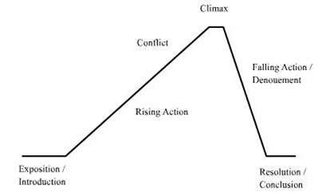
Short Stories vs Novels
Similarities
  Plot curve
  Characters
  Setting
Differences
  In Novels, scenes are steps toward the resolution
  Short Stories have little to no exposition and its primary focus is resolving ONLY the main conflict

Slide 8
Short Stories
Focus on a Key Moment
  In order to fit the story within a limited number of words, select the tipping point

Slide 9
Short Stories
Establish basic elements before writing
  Character(s)
    Make them interesting and believable
    Combine unusual characteristics
  Conflict
    Character WANTS something, but something or someone is in the way
  Scene
    Many short stories have one scene, make it good and interesting

Slide 10
Characters

Slide 11
Characters
What makes good characters?
  Definition
  Depth
  Heart

Slide 12
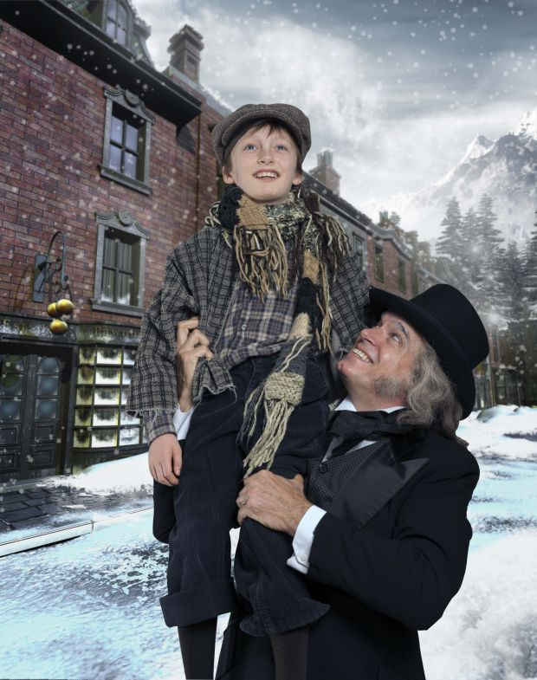

Characters - Definition
What they’re named
  Names are readers’ first impression
  Darth Vader, Scout, Harry Potter, Scarlett O'Hara
  Avoid main character names with the same first letter
What they look like
  Readers need a visual
  Helps to separate characters in readers’ minds

Slide 13
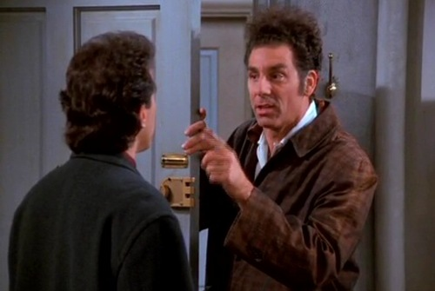
Characters - Definition
What they do
  Distinctive quarks
What they say
  Distinctive speech
What they think
  Creative, funny, odd, stupid, insane, etc.

Slide 14
Characters - Definition
What readers like in characters
  Has flaws
  Humble
  Good character (dependable / keep promises / honest)
  Live by morals / standards
  Helpful / compassionate (esp. for certain people)
  Funny / sense of humor
  Courageous, yet shows fear
  Relatable goals
  Down to Earth / level-headed / even-tempered
  Smart
  Cool (esp. in tense moments)

Slide 15
Characters - Definition
What readers don’t like in characters
  Perfect
  Liar / undependable / carelessly breaks promises
  Brags / sees themselves as superior
  Unsportsmanlike / unfair
  Self-serving
  Not funny / bad sense of humor
  Hidden cowards
  Unworthy goals
  Extreme behavior / mood swings
  Bullies others
  Whines and complains
  Panics under pressure

Slide 16
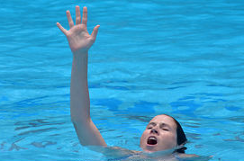
Characters - Want
ALL characters should want something (desire/goal)
  If a character doesn’t want something, he/she doesn’t belong in your story
  The stronger the want, the better
Needs: Air
Wants:
To Live

Slide 17
Characters - Depth
Secrets / Something under the surface
  Example: Leader of AA meetings hides liquor for himself
Contradiction
  Example: Black-wearing, goth-like, yet loves butterflies
  Example: Fights for equality, yet fiercely competitive
Personal History
  Background
  Past struggles / conquests
  Past relationships
  Deep-seeded interests, desires
  Leads to a vulnerability

Slide 18
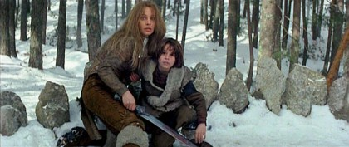
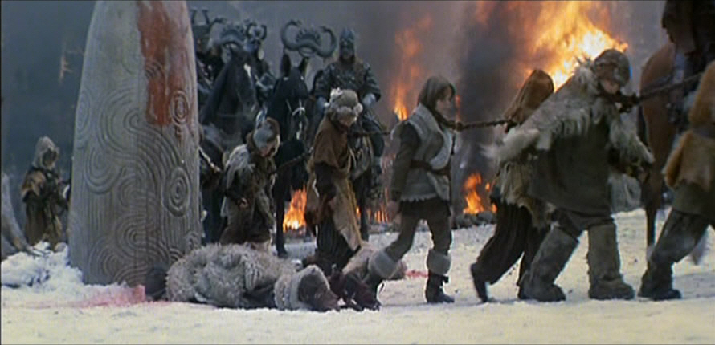
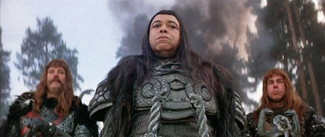
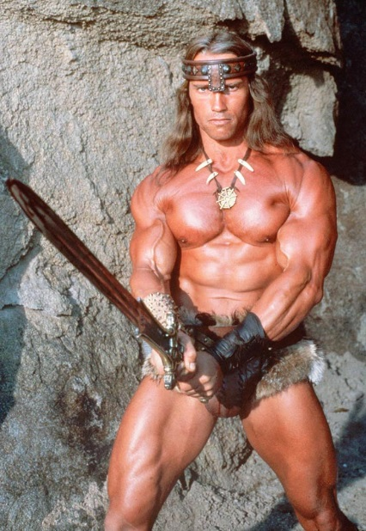
Characters - Depth
Boy Enslaved
Bad Guy Kills Mommy
Resentment Builds Boy into Warrior
Revenge

Slide 19
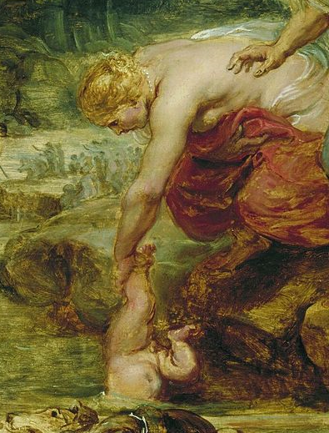
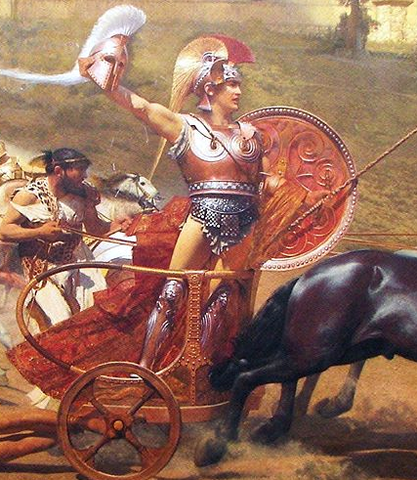
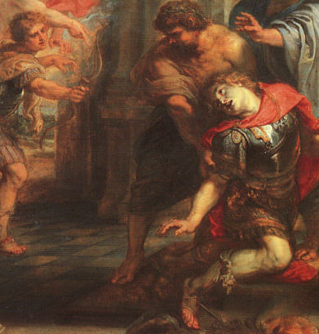
Characters - Depth
Vulnerability
  Achilles heel

Slide 20

Characters Group Activity
Character 1

Slide 21
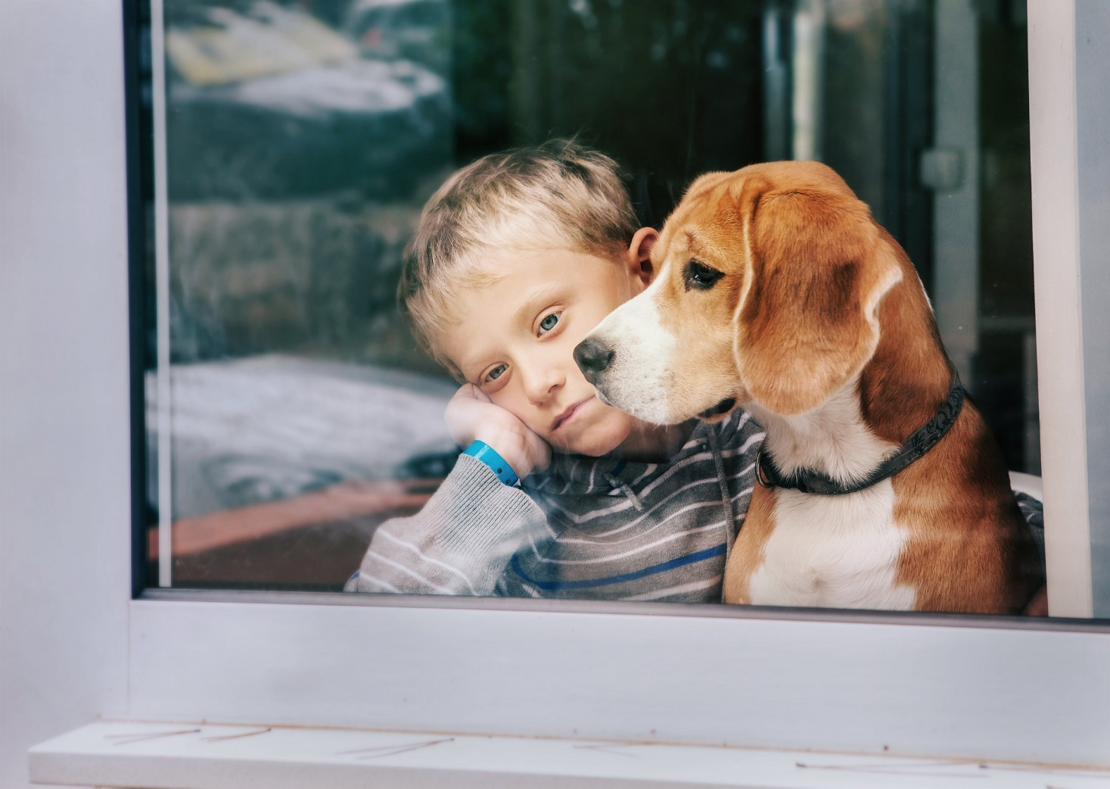
Characters Group Activity
Character 2

Slide 22
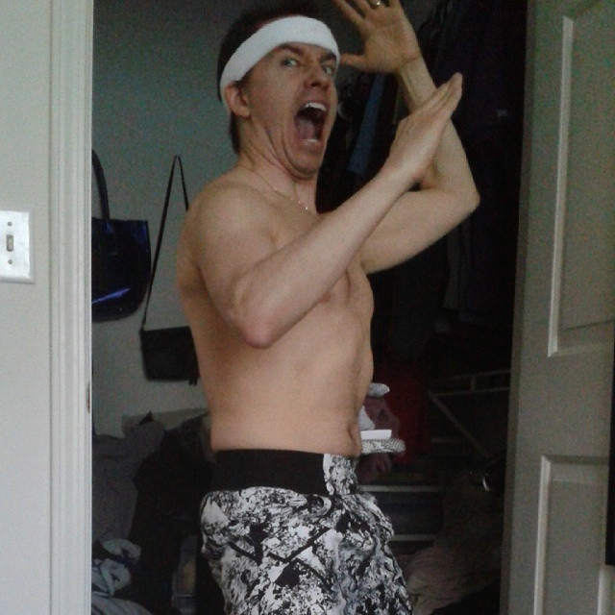
Character Individual Activity

Slide 23
Conflict

Slide 24
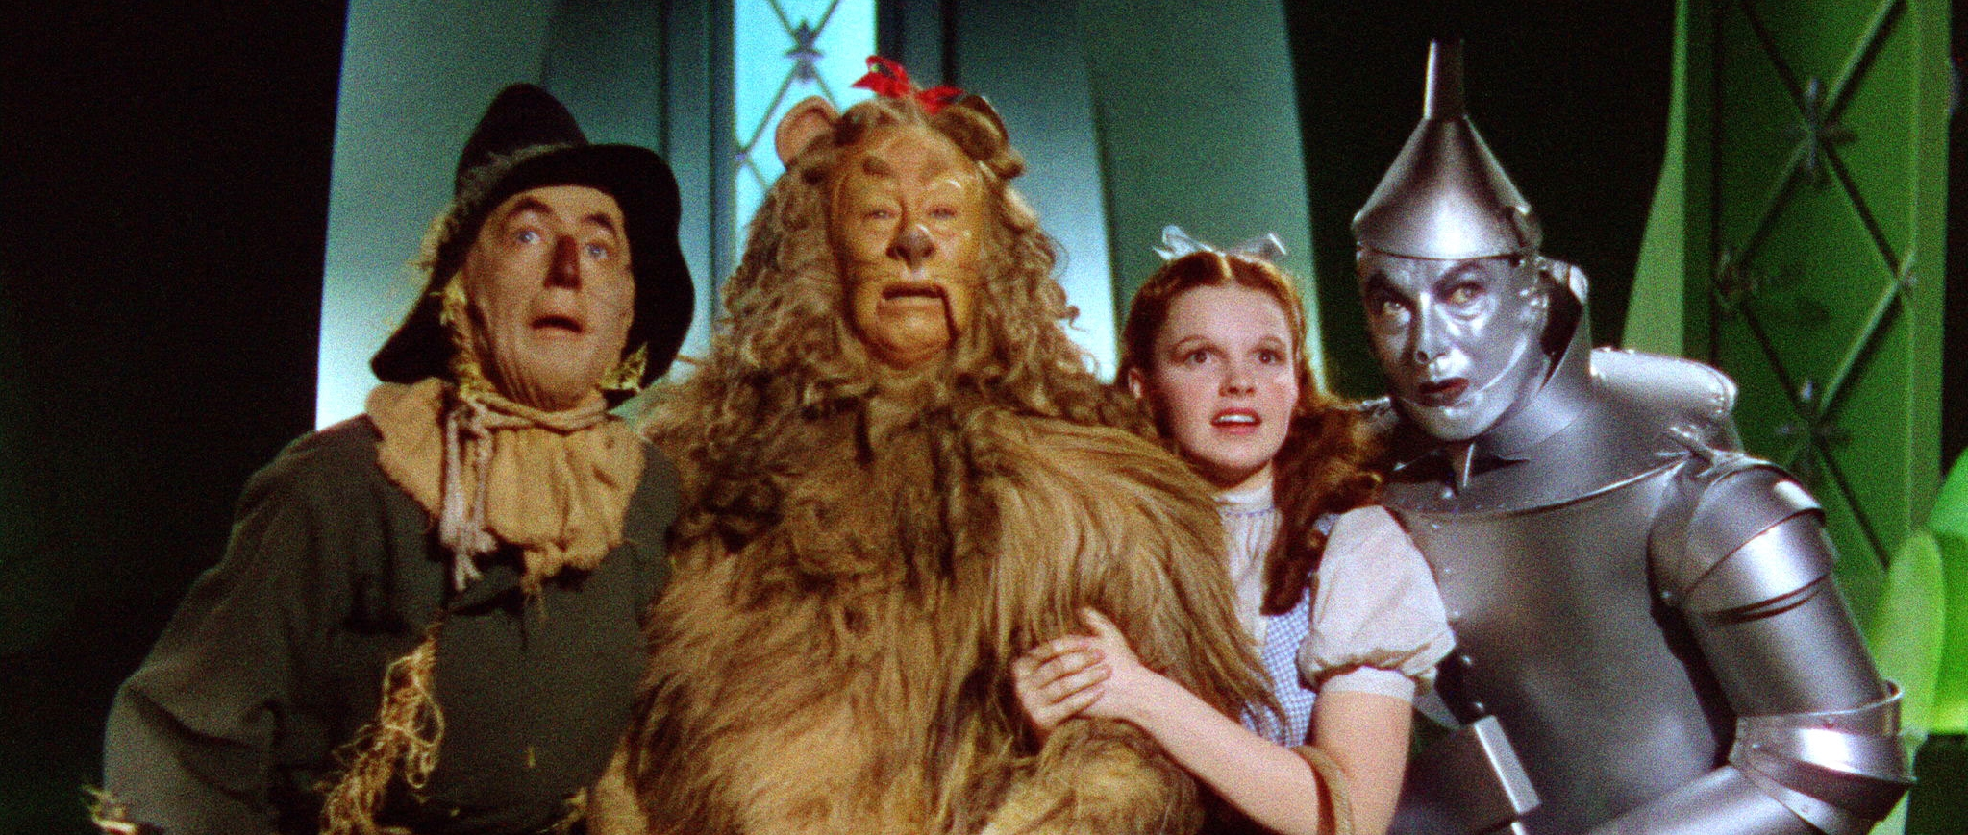
Conflict
Foundation of all storytelling is conflict
  Conflict = Story
  No Conflict = No Story
Definition of Conflict (from a story’s perspective)
  A character wants something, but something is in the way of getting what he/she wants

Slide 25
Conflict
What’s the source of conflict?
What’s at stake?

Slide 26
Source of Conflict
The Four Types of Conflict
  Character-vs-Character
  Character-vs-Self
  Character-vs-Nature
  Character-vs-Society
People
Situation

Slide 27
Source of Conflict
People Conflict (Character-vs-Character)
  Understanding why people conflict with each other will allow you to build good scenarios
Primary reason for Person-to-Person Conflict: MISCOMMUNICATION

Slide 28
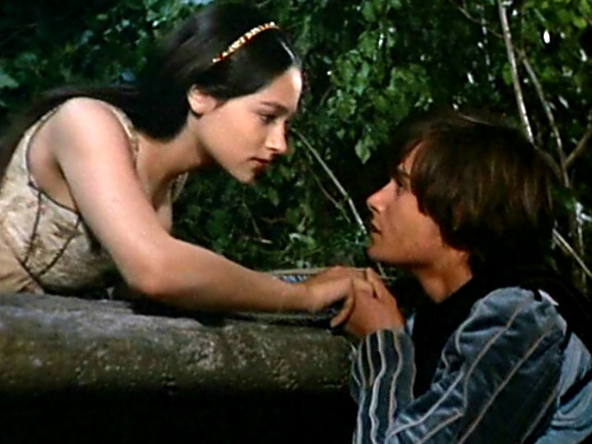
Classic Miscommunication
Juliet faked her death
Romeo thought she was dead, killed himself
When Juliet awoke and found Romeo dead, she killed herself

Slide 29
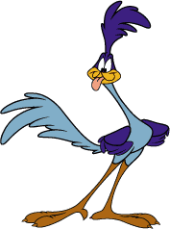
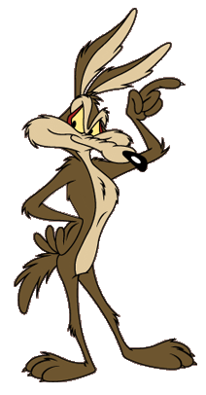
Miscommunication
A
C
Talking to the Road Runner
Talking to Wile E. Coyote
B
D
Understanding Wile E. Coyote
Understanding the Road Runner

Slide 30
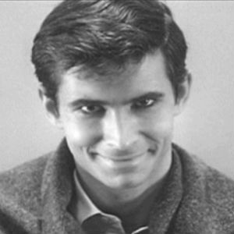
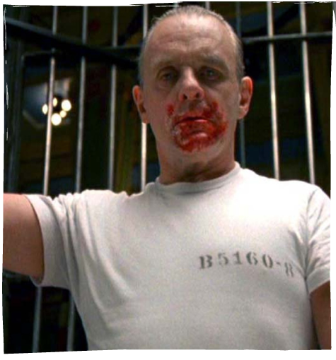
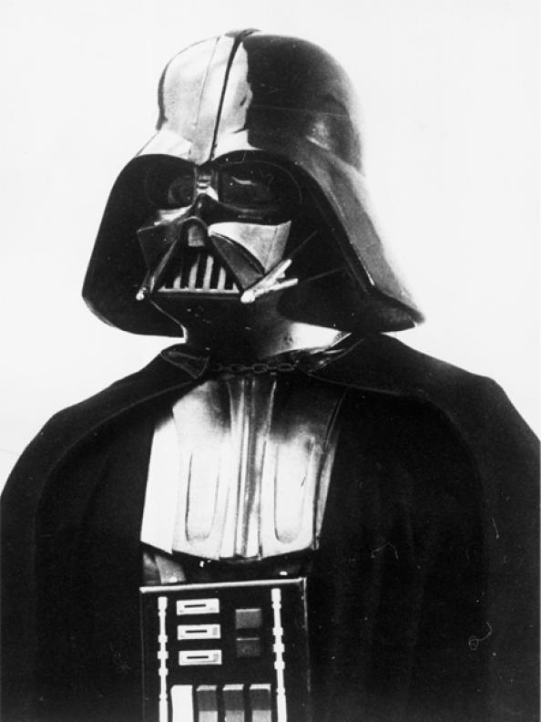
Source of Conflict
People Conflict (Character-vs-Self)
  Both Good Guys and Bad Guys should think they are right, based on their personal objectives/morals

Slide 31
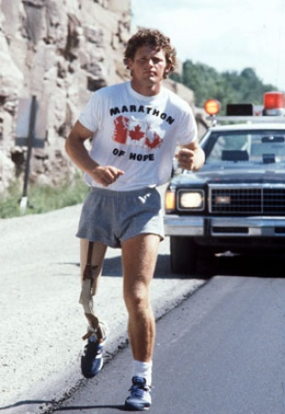
Source of Conflict
Situation Conflict (Character-vs-Nature)
  Can be very compelling since obstacles and situations often cannot be defeated or changed easily
Terry Fox
Embarked on a cross-Canadian run
Ran for 143 days, covering 3,339 miles before he died

Slide 32
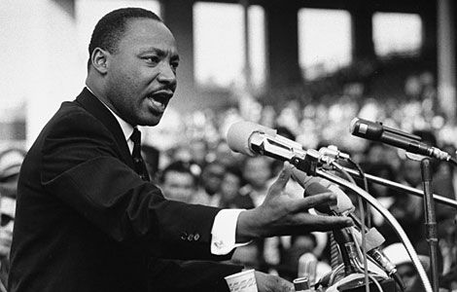
Source of Conflict
Situation Conflict (Character-vs-Society)
  Fighting the norms of society, or a specific group
Martin Luther King Jr
Pushed for peaceful reforms
Gave Inspiration to Millions

Slide 33
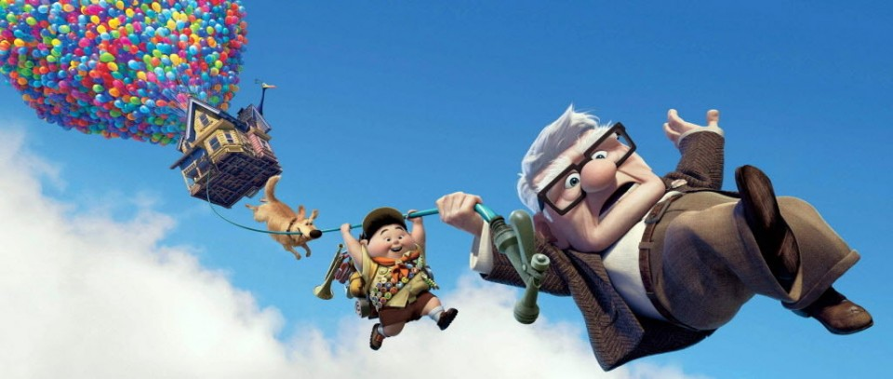
Conflict
Up against a wall
  When characters face resolution to their conflict, they often must ask themselves the following question:
  What is most important to him/her?

Slide 34
What’s at Stake?
Novels
  What’s at stake develops gradually through the course of the story
Short Stories
  The stakes may develop, but they need to rise quickly
In both cases: The Bigger the Better!

Slide 35
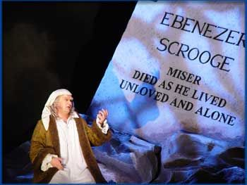
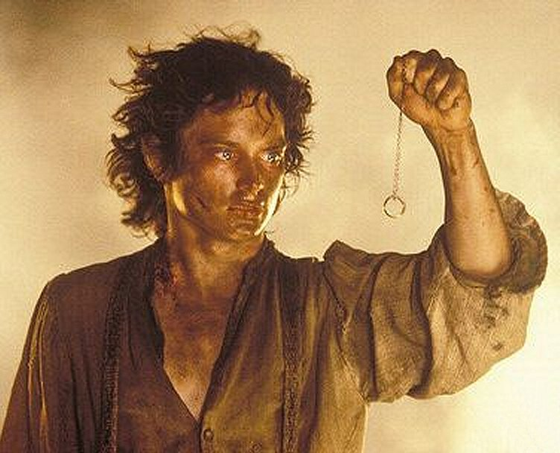
What’s at Stake?
A Christmas Carol: Ebenezer Scrooge
  At Stake: Wasting His Life,
  Tiny Tim’s Life,
  Bob Cratchit’s Family,
  Ebenezer’s Nephew
Lord of the Rings: Frodo
  At Stake: The Fate of Middle Earth

Slide 36
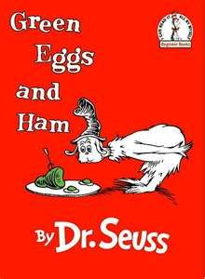
Conflict Activity 1
Identifying Conflict
Green Eggs and Ham
  Character-vs-Character
  Character-vs-Self
  Character-vs-Nature
  Character-vs-Society
What? Why?

Slide 37
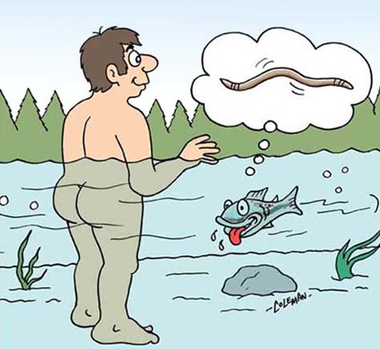
Conflict Activity 2
Identifying Conflict
Comic
  Character-vs-Character
  Character-vs-Self
  Character-vs-Nature
  Character-vs-Society
What? Why?

Slide 38


Conflict Activity 3
Creating Conflict
  Character-vs-Character
  Character-vs-Self
  Character-vs-Nature
  Character-vs-Society
Verses
What? Why?

Slide 39
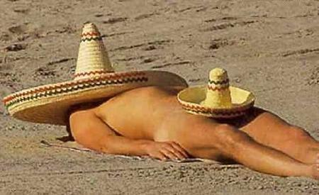
10-Minute Break

Slide 40
Description and Dialog

Slide 41
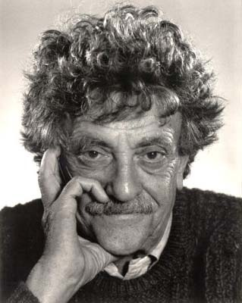
Description and Dialog
Description and Dialog
  Both paint the picture of the characters and their world
Warning!
  Too much of either can drown your story
“Every sentence must do one of two things—reveal character or advance the action.” – Kurt Vonnegut

Slide 42
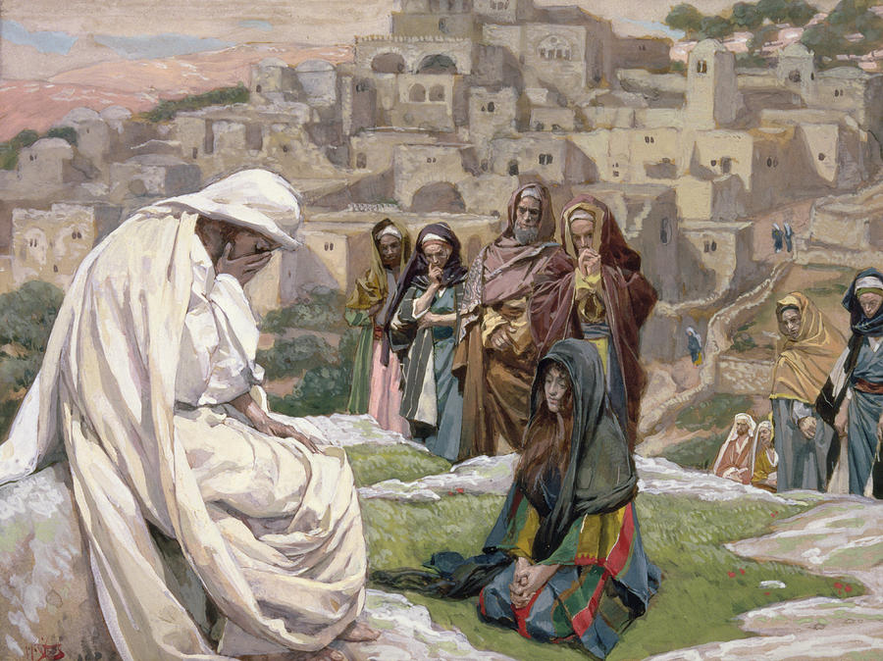
Description
The power of “Less is More”
  Using fewer, more powerful words makes writing stronger
Example:
  “Jesus wept.” - John 11:35

Slide 43
Description
Efficiency in Descriptions
  Rather than going overboard with flowery language, select the best details, and then move on
Bad Example
  In this day and age, lazy, sloth-like young people hang out inside the house doing absolutely nothing literately all day.
Revised
  Now days, kids are lazy. They play video games instead of kickball.

Slide 44
Description
The Description Rules
  Be specific, Avoid ambiguity
    Bad: “Sally ate a pastry.”
    Good: “Sally ate a jelly donut.”
  Use action verbs
    Bad: “Jeff went to the kitchen.”
    Good: “Jeff skipped to the kitchen.”
  Avoid adverbs and passive voice
    Bad: “Mary was dutifully taken to school.”
    Good: “Mom drove Mary to school every day.”

Slide 45
Description
The Description Rules
  Use senses (sight, sound, taste, touch)
    Bad: “Kevin saw the machine in the garage.”
    Good: “With repeating clanging pistons and a whiff of burning oil, Kevin felt at home in a stuffy garage.”
  Use appropriate language / descriptions
    Bad (maybe): “Four-year-old Katie thought the piece of cake towered on her plate like the Leaning Tower of Pisa.”
    Good: “Four-year-old Katie thought the piece of cake was bigger than Daddy’s head.”

Slide 46
Description
The Description Rules
  Avoid duplicating descriptions
    Bad: “Allister had a huge, enormous, big zit on his nose.”
    Good: “Allister had an enormous zit on his nose.”
    Bad: “Betty’s noisy cat was louder than a fire alarm.”
    Good: “Betty’s cat was louder than a fire alarm.”
  Avoid repurposing words
    Bad: “Zach looked at Tom – he looked surprised.”
    Good: “Zach noticed Tom was surprised.”
    Better: “Zach noticed Tom’s raised eyebrows and dropped jaw.”

Slide 47
Description Activity 1
Mr. Stevens, who was my former neighbor, won his lawsuit.
There is a chat area on the Web called Study Hall that encourages students to talk with one another about college courses.
He carries a briefcase made out of leather.
He carries a briefcase made out of leather that is weather-beaten.
The company is taking applications at this point in time.

Slide 48
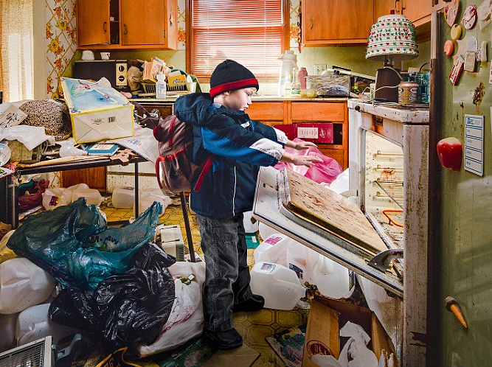
Description Activity 2
Be Specific
Action Verbs
Use Senses

Slide 49
Dialog
Give each character a “language” (one or more of the following or some other distinctive quality):
  Dialect / mispronunciations (just enough)
  Use specific words / phrases
    Elegant wording verses short/choppy
    Repeated expressions
    Misuse of words
  Be true to your characters
Keep the plot moving, always
  Avoid babbling dialog

Slide 50
Dialog
The Don’ts
  Info Dumps
  Repeated Long-winded Monologues
  Too Much Unreadable Dialect
  Too Much Info Unrelated to Anything
  Too Much Talking, Not Enough Action
  Melodramatic Expressions and Dialog Tags:
    “Get me a glass of milk!” Mom exclaimed.
    “We’re out of milk!” Jimmy retorted.
    “Oh, no! For milk is the source of life!” Mom belted.
    “I know!” Susie quipped. “I’ll dash to the store!”

Slide 51
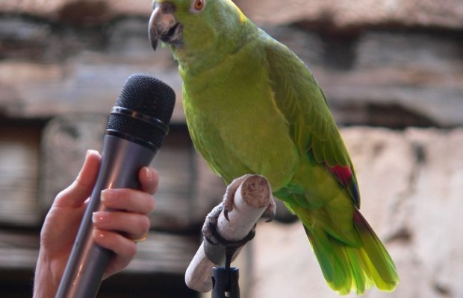
Dialog
Listen to actual people talk and mimic (to a degree) in your story’s dialog

Slide 52
Dialog
Make it real, but efficient. Short, choppy lines often do the trick.
Example:
  I scowled at Randy. “I don’t care, Bubbles.”
  “Stop calling me that.”
  “Stop calling me Goth.”
  “Whatever, Marshall.” He said my name as if it left a sour taste in his mouth.

Slide 53
Dialog
Character Complexity
The hard part about good dialog is the characters’ complexity
  Each character has distinctive motives and objects
  Often, characters don’t know how to express themselves
  There are things some characters don’t want to say

Slide 54

Dialog Activity 1

Slide 55
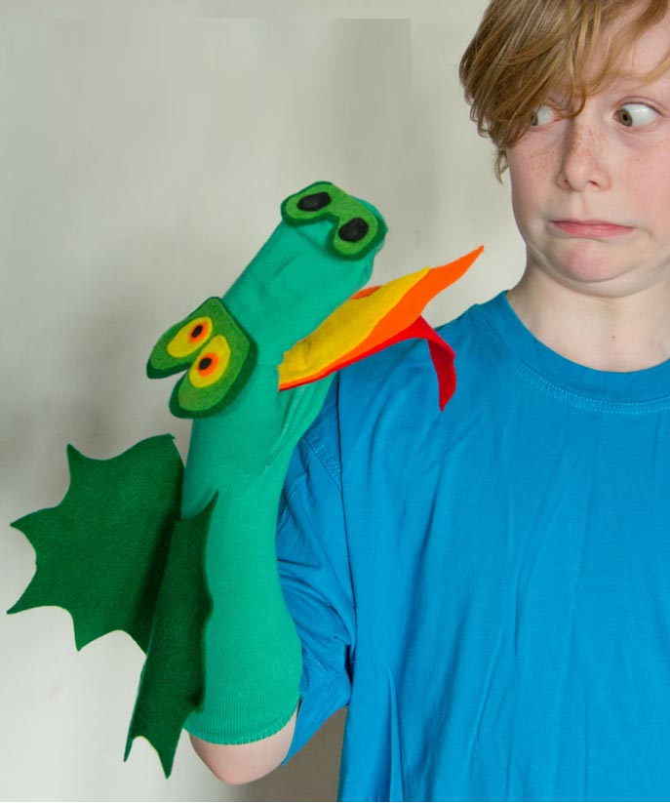
Dialog Activity 2
Sock puppets

Slide 56
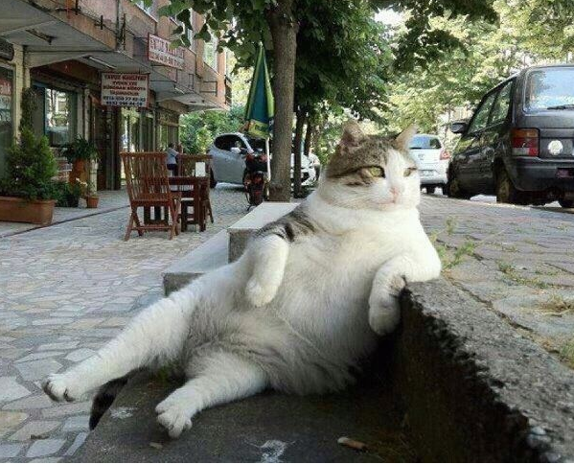
10-Minute Break

Slide 57
The Dreaded Re-Write

Slide 58
The Dreaded Re-Write
First Draft
  Get it done, fix it later
Re-Write Goals
  Clean up mistakes (grammar, spelling, clarity, etc.)
  Reduce wordiness, replace words/phrases to avoid
  Vivid details and descriptions
  Deepen characters / interactions
  Get more out of each scene
  Discover theme and focus story on it

Slide 59
The Dreaded Re-Write
Clean up Mistakes
Spelling/grammar checker works 90% of the time
Read story out loud
Be as clear as possible
Don’t assume an editor will find all mistakes

Slide 60
The Dreaded Re-Write
Words/Phrases to Avoid
Adverbs
Extraneous Adjectives
Oh, yeah. And these (among others):
  added/in addition
  about
  first began
  almost
  ask a question
  anxiously
  believe
  eagerly
  every
  feel
  finally
  frequently
  got
  just
  merely
  nearly
  need
  back up
  written down
  but
  often
  only
  so
  that
  very
  then
  unique
  presently
  at the present time

Slide 61

The Dreaded Re-Write
Vivid Details and Descriptions
Sight, Smell, Touch, Taste, Sound
Be a sniper
  Pick a few very specific details, and move on

Slide 62
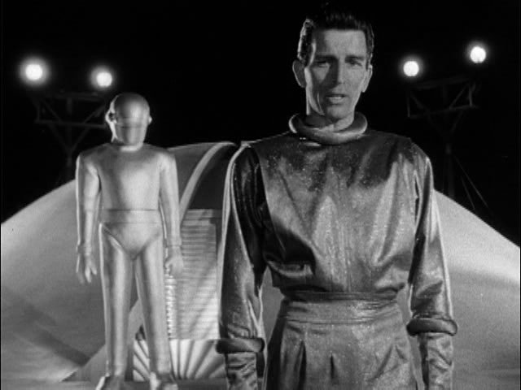
The Dreaded Re-Write
Deepen Characters / Interactions
You don’t have to know everything about a character in the first draft
  During the re-write, put yourself in his/her shoes
  Complete his/her story
  Reveal characters’ personality, history, and nuances over time

Slide 63
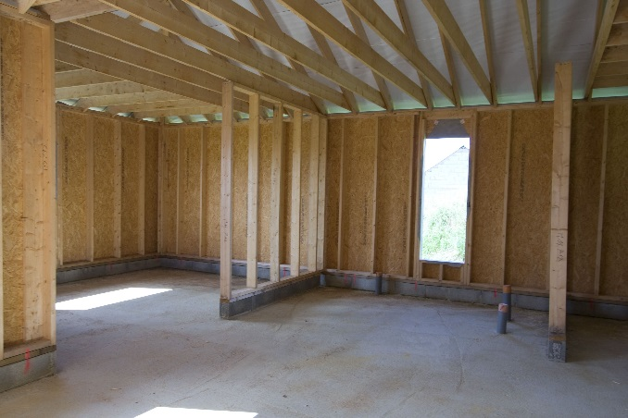
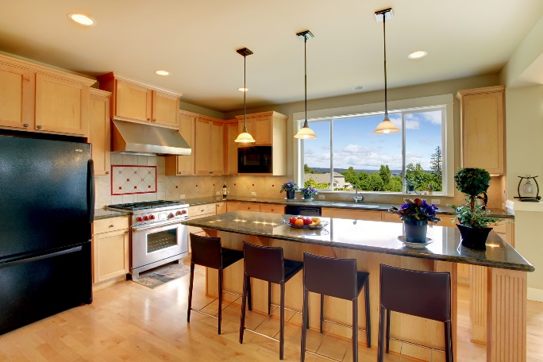

The Dreaded Re-Write
Get More Out of Each Scene
Keep adding details that…
  Advance the Plot and Reveal Character

Slide 64
The Dreaded Re-Write
Discover Theme and Focus Story On It
What’s the point? What are you telling the reader?
  What’s important to you, personally?
  Leave an impression on your reader

Slide 65
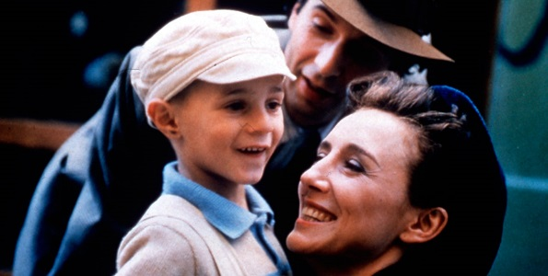
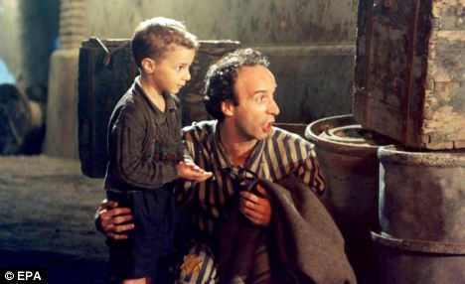
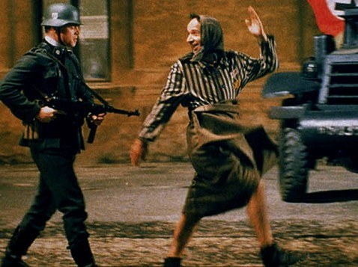
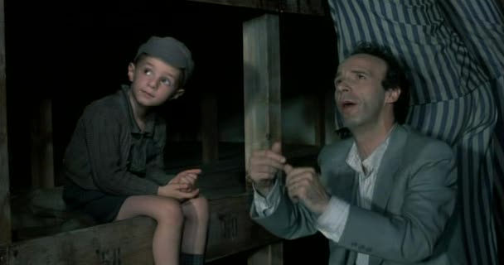
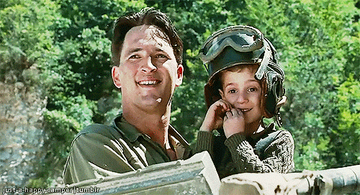
The Dreaded Re-Write
Discover Theme and Focus Story On It
Example: Life is Beautiful

Slide 66
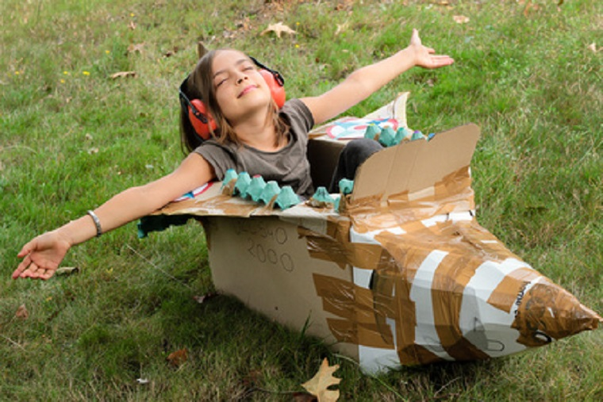
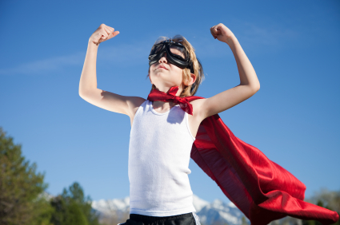
Short Story Writing
Closing
Read. Learn. Observe.
Have Fun! Be the captain of your imagination.

Slide 67
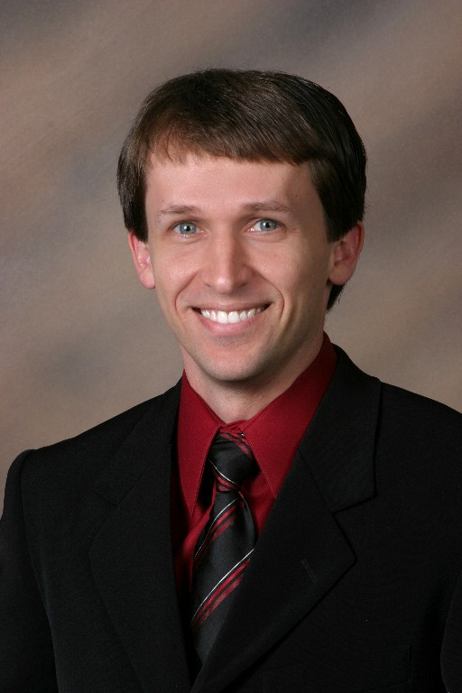

Short Story Workshop
Thank You for Attending

