Slide 1
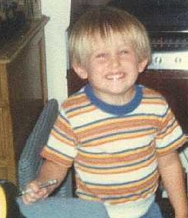
Short Story Writing
Presenter
John Hope
Multiple Short Story Winner…
  Royal Palm Literary Awards
  CrossTIME Science Fiction/Fantasy Awards
  Ron L Hubbard Writers of the Future Award

Slide 2
Short Story Writing
Short Story Overview
How to Write a Short Story
Story Development Methods
Story Planning Activity
Pop Quizzes

Slide 3
Short Story Overview
Short Story Writing

Slide 4
Short Story Overview
What defines a short story?
  Often between 1k to 5k words, less than 20k
  Contains a COMPLETE story
    Main conflict resolution
    Character arc
  Rich with scene and character description and dialogue
RPLA Guidelines
  Short fiction has many of the elements of a novel, including character, setting, plot, conflict, resolution, climax, dialogue, protagonist, and antagonist. Maximum 8,000 words.

Slide 5
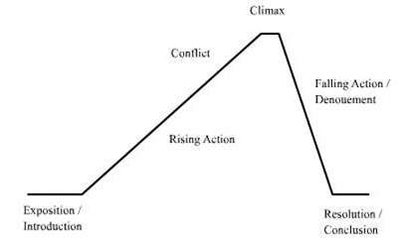
Novel Writing – Comparison
Similarities
  Plot curve
  Characters
  Setting
Differences
  In Novels, scenes are steps toward the resolution
  Short Stories have little to no exposition

Slide 6
Making it Happen
How do I squeeze an entire story into 5k to 8k words, and sometimes less?
Assumptions
  You’re experienced writing novels / novellas
  New to writing the “shorter stuff”
  Or you’re here to heckle me

Slide 7
Pop Quiz #1
According to the RPLA Guidelines, short stories should include character, setting, plot, protagonist, antagonist, and the following:
  A) conflict, plot twist, climax, dialogue
  B) conflict, resolution, climax, dialogue
  C) conflict, rising action, climax, dialogue
  D) Rik Feeney in a turtleneck

Slide 8
Pop Quiz #1
According to the RPLA Guidelines, short stories should include character, setting, plot, protagonist, antagonist, and the following:
  A) conflict, plot twist, climax, dialogue
  B) conflict, resolution, climax, dialogue
  C) conflict, rising action, climax, dialogue
  D) Rik Feeney in a turtleneck

Slide 9
How to Write a Short Story
Short Story Writing

Slide 10
How to Write a Short Story
Focus on a Key Moment
  In order to fit the story within a limited number of words, select the tipping point

Slide 11
How to Write a Short Story
Establish basic elements before writing
  Conflict
    Character WANTS something, but something/ someone is in the way
  Character(s)
    Make them interesting and believable
    Combine unusual characteristics
  Scene
    Many short stories have one scene, make it good

Slide 12
How to Write a Short Story
Write
  Start as late in the story as possible
  Finish draft as quickly as possible
    Don’t fret over details (grammar)
  Maintain one point of view
  Once you reach resolution of the main conflict, end the story as soon as possible

Slide 13
How to Write a Short Story
Rewrite
  Don’t attempt the same day draft was written
  Be as clear as possible for the reader
    Guide them through your story
  Clean up, eliminate needless words, phrases
  Ensure theme is maintained throughout
  Strong opening scene/sentence
  Audience – will it be accepted?

Slide 14
How to Write a Short Story
Share with trusted readers
  Writing critique groups, etc
    Listen to and consider feedback
  Don’t let others’ feedback kill your baby
    Maintain your message / theme

Slide 15
Pop Quiz #2
According to this presentation, what is the tipping point of a story?
  A) Final rise of conflict, climax, and start of the fall to resolution
  B) Previously rare phenomenon becoming rapidly and dramatically more common
  C) Following the exposition, when conflict starts to increase tension
  D) When you’ve had too much beer

Slide 16
Pop Quiz #2
According to this presentation, what is the tipping point of a story?
  A) Final rise of conflict, climax, and start of the fall to resolution
  B) Previously rare phenomenon becoming rapidly and dramatically more common
  C) Following the exposition, when conflict starts to increase tension
  D) When you’ve had too much beer

Slide 17
Pop Quiz #3
In short story writing, what should you do after you resolving the story’s main conflict?
  A) Include one more scene to wrap up other conflicts in the story
  B) Explain the meaning of the story to the reader
  C) End the story as soon as possible
  D) Burn all of your clothes and scamper through the backyard

Slide 18
Pop Quiz #3
In short story writing, what should you do after you resolving the story’s main conflict?
  A) Include one more scene to wrap up other conflicts in the story
  B) Explain the meaning of the story to the reader
  C) End the story as soon as possible
  D) Burn all of your clothes and scamper through the backyard

Slide 19
Pop Quiz #4
When should you start the re-write process of your short story?
  A) At least a day or so later, preferably longer
  B) Immediately after completing the draft
  C) After others read your story
  D) When ALF comes back to primetime TV

Slide 20
Pop Quiz #4
When should you start the re-write process of your short story?
  A) At least a day or so later, preferably longer
  B) Immediately after completing the draft
  C) After others read your story
  D) When ALF comes back to primetime TV

Slide 21
Story Development Methods
Short Story Writing

Slide 22
Story Development Methods
There are a gazillion ways to develop a story
This presentation covers only 3 methods
Experience will provide you with many, many more ways

Slide 23
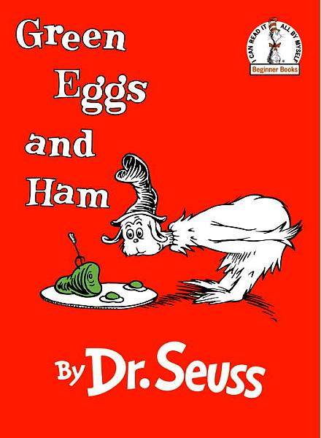
Method 1 – Theme First Approach
Come up with your theme first
Then devise a main conflict that opposes the theme
Example:

Slide 24
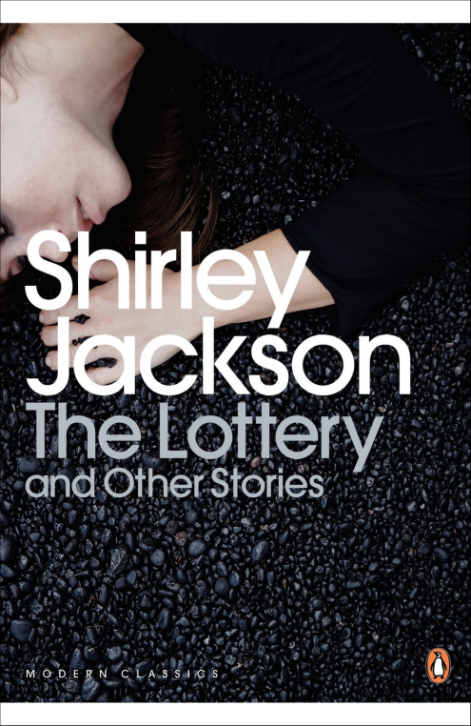
Method 2 – Great Scene Approach
Come up with a great scene
Extract a main conflict that could arise within that scene
Theme centers on the resolution of the main conflict
Example:

Slide 25
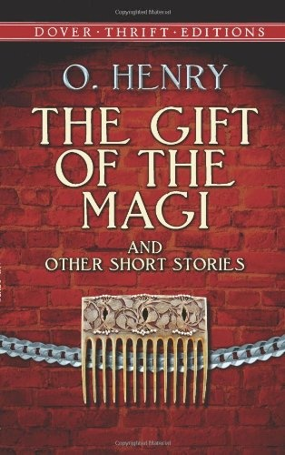
Method 3 – Twist Ending Approach
Come up with a main conflict that has at least two plausible endings
Guide reader toward the more obvious ending
In good twist endings, the less obvious ending has larger implications
Example:

Slide 26
Story Planning Activity
Short Story Writing

Slide 27
Story Planning (Handout)
Develop story using Method 1 Theme First Approach

Slide 28

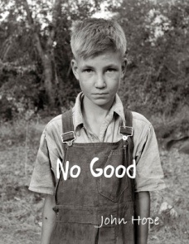
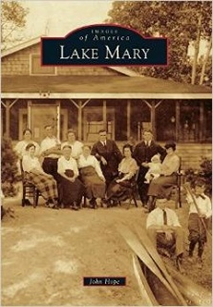
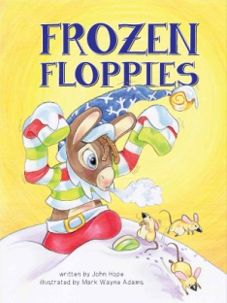
Short Story Writing
John Hope
Follow up questions?
john@johnhopewriting.com
www.johnhopewriting.com
Award-Winning Books
Presentation Available
www.johnhopewriting.com/teachers.html

