Slide 1
Young Adult Writing
John Hope
www.johnhopewriting.com

Slide 2
Young Adult Writing - Agenda
Select the Right Topic
Your Leading Character
Think Like Your Audience

Slide 3

Select the Right Topic

Slide 4
Select the Right Topic
Young Adult Writing is NOT “Dumbed Down” Adult Writing
Hot / Serious Topics
Don’t Water Down the Truth

Slide 5
Select the Right Topic
What’s important to teens?
  Friends and Meaningful Relationships
  What Other People Think About Them
  A Sense of Self
  Grades / School
  Their Future

Slide 6

Select the Right Topic
Harry Potter’s Struggles:
  Making Friends
  Fitting in the “right” House
  Discovering his hidden potential
  Surviving wizard school
  Saving the world from Voldemort

Slide 7
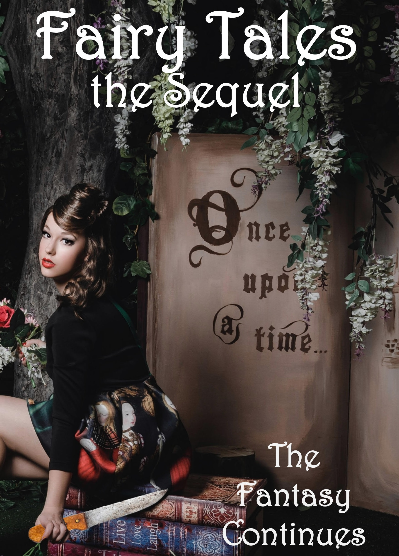
Select the Right Topic
Provide the audience interesting ideas, settings, and scenarios

Slide 8
Select the Right Topic
Keep in mind, kids buys books, adults buy MORE books
  Need to sell concepts to parents and teachers
  What are topics are adults comfortable with exposing to their kids

Slide 9



Select the Right Topic
Schools
  Focus on learning
  Historical topics
  Science/Technology

Slide 10
Select the Right Topic
Taboos
  Sex
  Nudity
  Vulgarity
  Excessive Violence
  Drug use
All Taboos CAN be addressed – go light on the descriptions

Slide 11
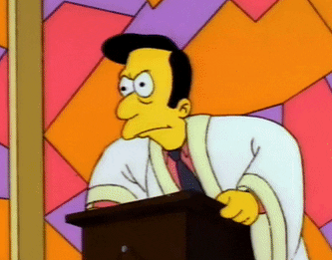
Select the Right Topic
Don’t get preachy, just tell your story
  Trust your audience will get it

Slide 12
Select the Right Topic
Satisfying endings
  Doesn’t have to be happy, but it should be hopeful
  A better life is coming
  Characters have changed (character arc)

Slide 13
Select the Right Topic
Remember to Hook Your Audience
  Overarching story huge and epic (sounds good)
  The core of your story deep and character-centric

Slide 14
Select the Right Topic
Teen Hooks
  Dystopian
  Starkly realistic
  Stories that challenge their world view
  Push the limits of what’s acceptable
Tween Hooks
  Funny, adventurous
  Similar activities of reader
  Bordering on unbelievable premises

Slide 15
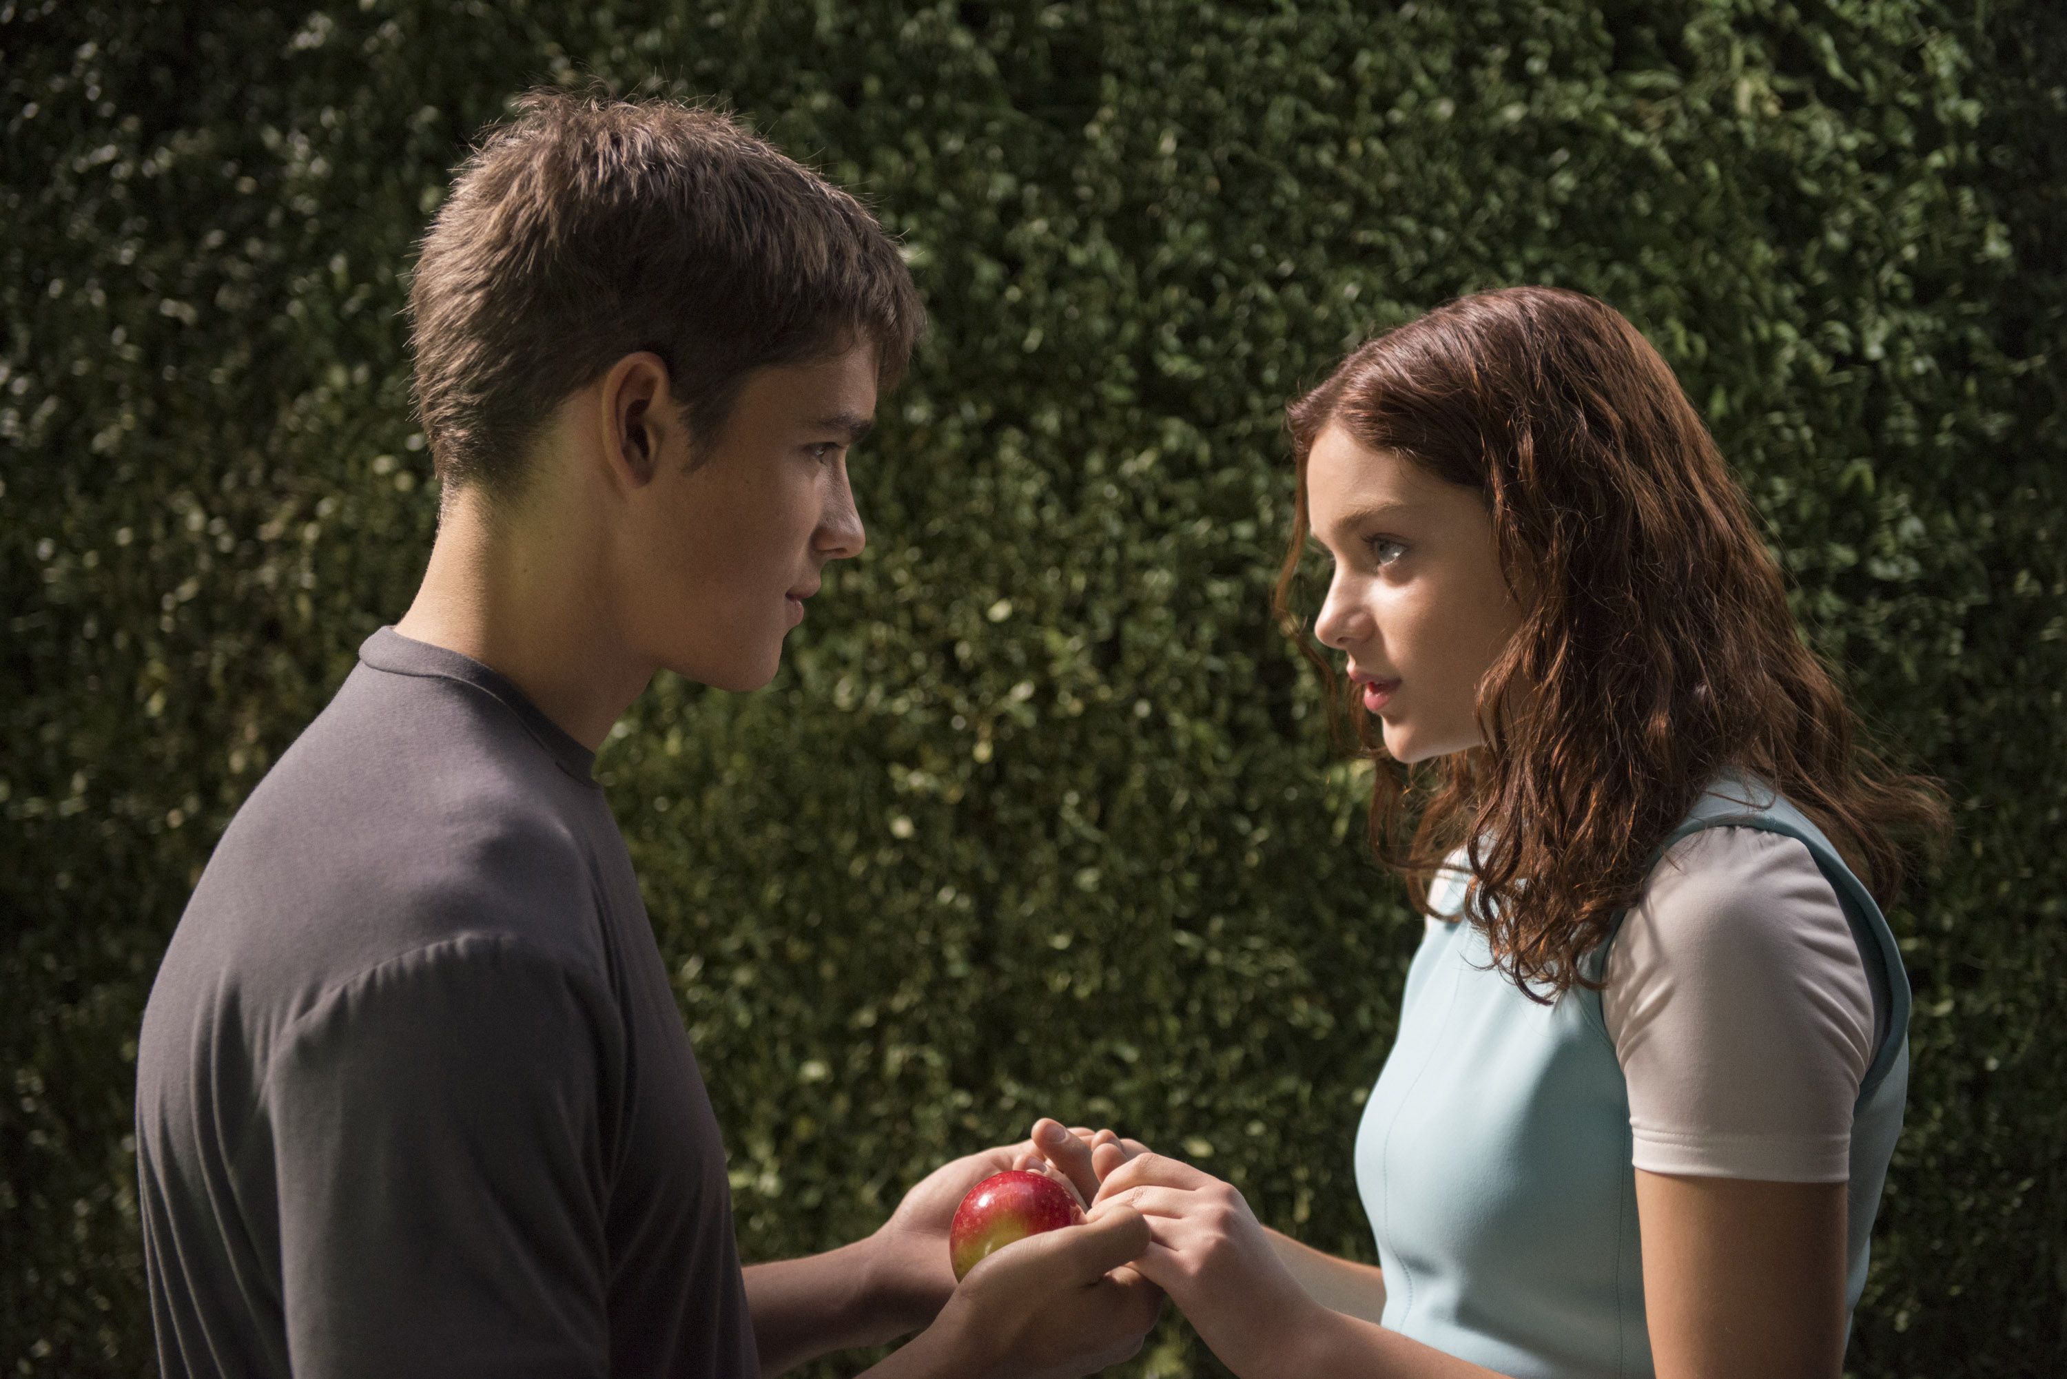
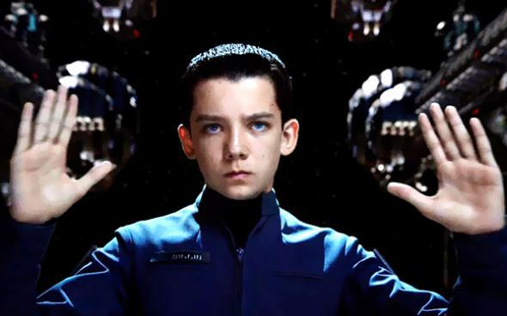
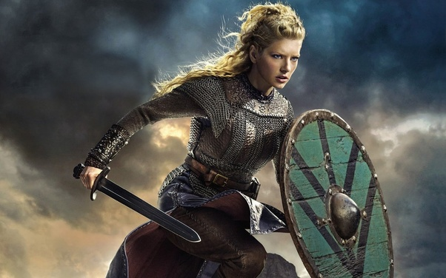
Your Leading Character

Slide 16
Your Leading Character
Select the character(s) to match your audience
  Same age or slightly older
  Similar problems / desires / wants
  Avoid stereotypes

Slide 17
Your Leading Character
Point of View
  NO RETROSPECTIVE WRITING – No adult wisdom
  Allow kid characters to make kid mistakes
  Thoughts and reactions should be appropriate for what your character knows / understands

Slide 18
Your Leading Character
Voice
  Select genuine voice for your character(s), each should be unique
  Characters themselves may be searching for their voice
    Speak differently amongst their friends vs adults

Slide 19
Your Leading Character
Fully developed characters
  Tell something NEW about your main characters in EVERY scene
  Allow readers to become friends with the characters
  Show multiple sides to each character

Slide 20
Your Leading Character
Character example:
  Bruce, he plays football
  Big and bullish-looking
  Loves dogs and wants to be a vet
  Struggles with math, but takes Honors Algebra because a girl he likes in the class
  Obsessed with eating pickles
  Has a neighbor with Down’s syndrome who he gives piggy-backs rides
  He cried when saw the Fox and the Hound

Slide 21

Think Like Your Audience

Slide 22
Think Like Your Audience
Types of kids haven’t changed
Environments, situations, technologies have changed – DRAMATICALLY
  Kids have changed to adapt

Slide 23
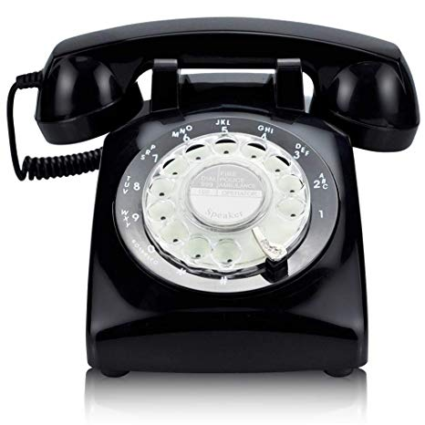
Think Like Your Audience
Understanding of Technology
  What do kids know, and what don’t they know?
Terminology
  Use the CORRECT terms in the CORRECT context

Slide 24
Think like your audience
Basic Desires of Teens (13-19):
  Sense of identity, self
  Meaningful relationships, beyond childhood friends
  Gain confidence in adult responsibilities
  Question what they’ve learned
  Start to take ownership of their own lives

Slide 25
Think like your audience
Basic Desires of Tweens (10-12):
  Cares what adults think of them
    They start to challenge authority
    Don’t want adults around
    They still need love/support
  Activities (games or sports) more important than hygiene
  Embarrassment, fitting in
  Want to do grown up things

Slide 26
Think like your audience
What do kids generally don’t worry about?
  Paying bills
  Carrying for others’ welfare
  Cooking dinners
  Managing carpools/transportation
  Next day consequences
  Their own mortality

Slide 27
Think like your audience
Propel your story with the concerns of your audience

Slide 28

Think like your audience
Main character, Jonas, has lived a cookie-cutter life
He has a moment of enlightenment
He decides to live his own life, away from his family
He rebels, breaks the rules, and leaves

Slide 29
Think like your audience
Teens React: The Hunger Games (01:50 onward)
  How real they view the story
  How they relate it to their lives
  How they understand the symbology
  Their general reactions

Slide 30
Young Adult Writing
Questions?
Presentation Available: www.johnhopewriting.com

